Slide 1
Japanese Activities in
Nuclear Data Measurement
Hideo HARADA
Japan Atomic Energy Agency
on behalf of
Masayuki IGASHIRA¹ and Hideo HARADA²
¹Tokyo Institute of Technology
²Japan Atomic Energy Agency

Slide 2
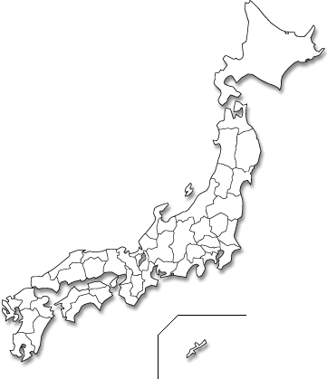
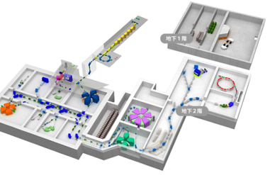

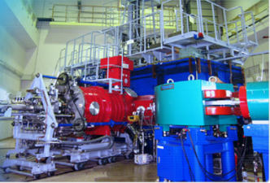
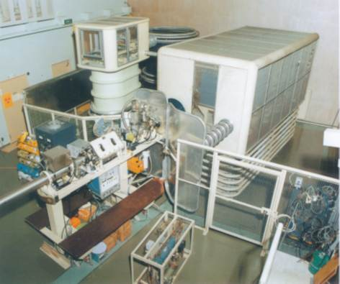
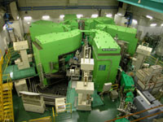
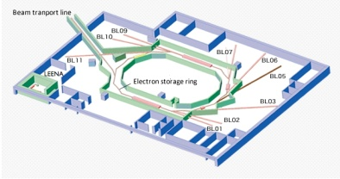
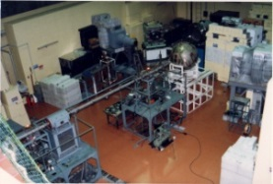
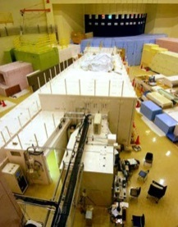
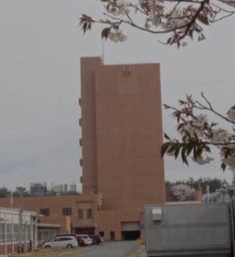
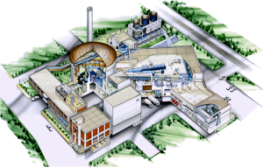
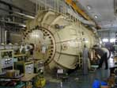
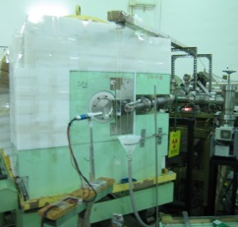
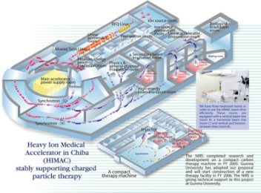
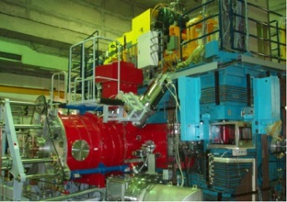
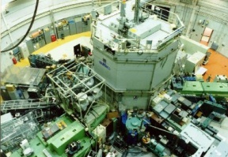
Nuclear Data Measurement in Japan
Nuclear data measurements are being performed at several accelerator and reactor facilities in Japan:
RIBF@RIKEN
TIARA@JAEA
CYRIC@Tohoku
FNS@JAEA
New SUBARU
RCNP
OKTAVIAN
ANNRI/MLF/
/J-PARC@JAEA
Tandem
@JAEA
JRR-3
@JAEA
KUTL
TIT
KUR
KURRI-LINAC
HIMAC @NIRS
Cyclotron @NIRS

Slide 3
Activities by
J-PARC/MLF/ANNRI collaboration
Japan Atomic Energy Agency
Tokyo Institute of Technology
Hokkaido Univ.
Kyoto Univ.
Contact :
Nuclear Data Center
Nuclear Data and Reactor Engineering Division
Nuclear Science and Engineering Center
Japan Atomic Energy Agency

Slide 4
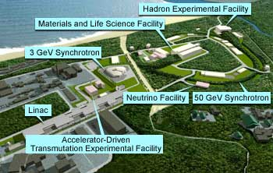
Nuclear Data Projects in Japan
Neutron capture cross sections are being measured at
BL04 of J-PARC MLF.

Slide 5
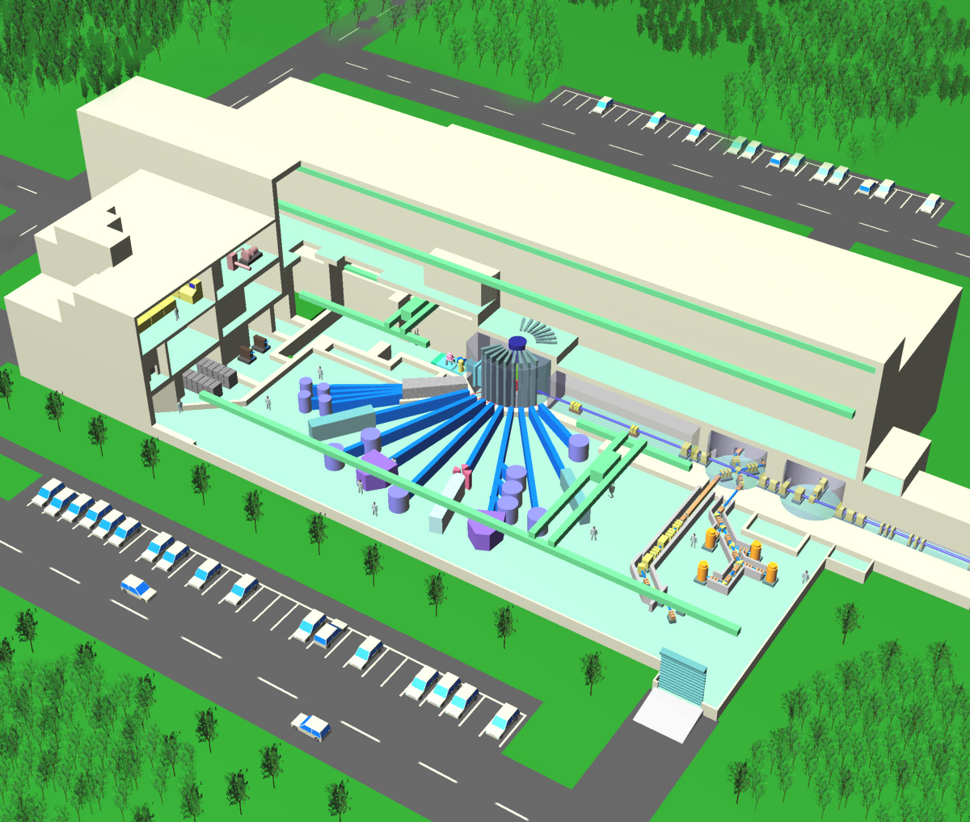
J-PARC Materials and Life Science Experimental Facility
Since April 2015, 500-kW Power Operation!
Building dimension :
Width : 70m
Length : 146m
Height : 30m
Exp. Hall Height : 22m
Target remote handling room
Cooling systems
(Basement)
1MW Spallation Target Station
Proton beam line
BL04: Nuclear
Data Beam Line
Spallation Mercury target
3GeV, 1MW proton beam
Experimental hall
23 neutron beam lines will be Installed in experimental halls under present design.
J-PARC MLF,
Taken from HP of J-PARC

Slide 6
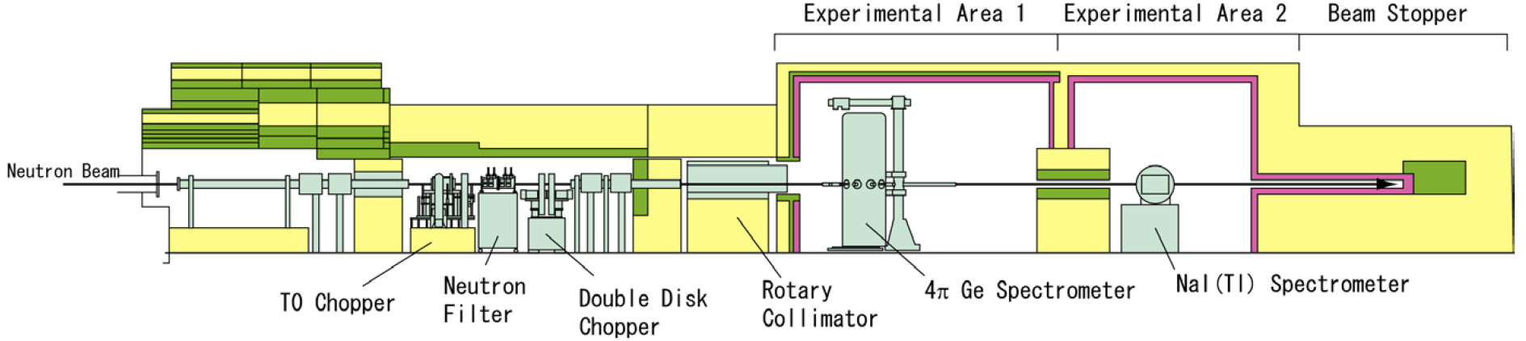
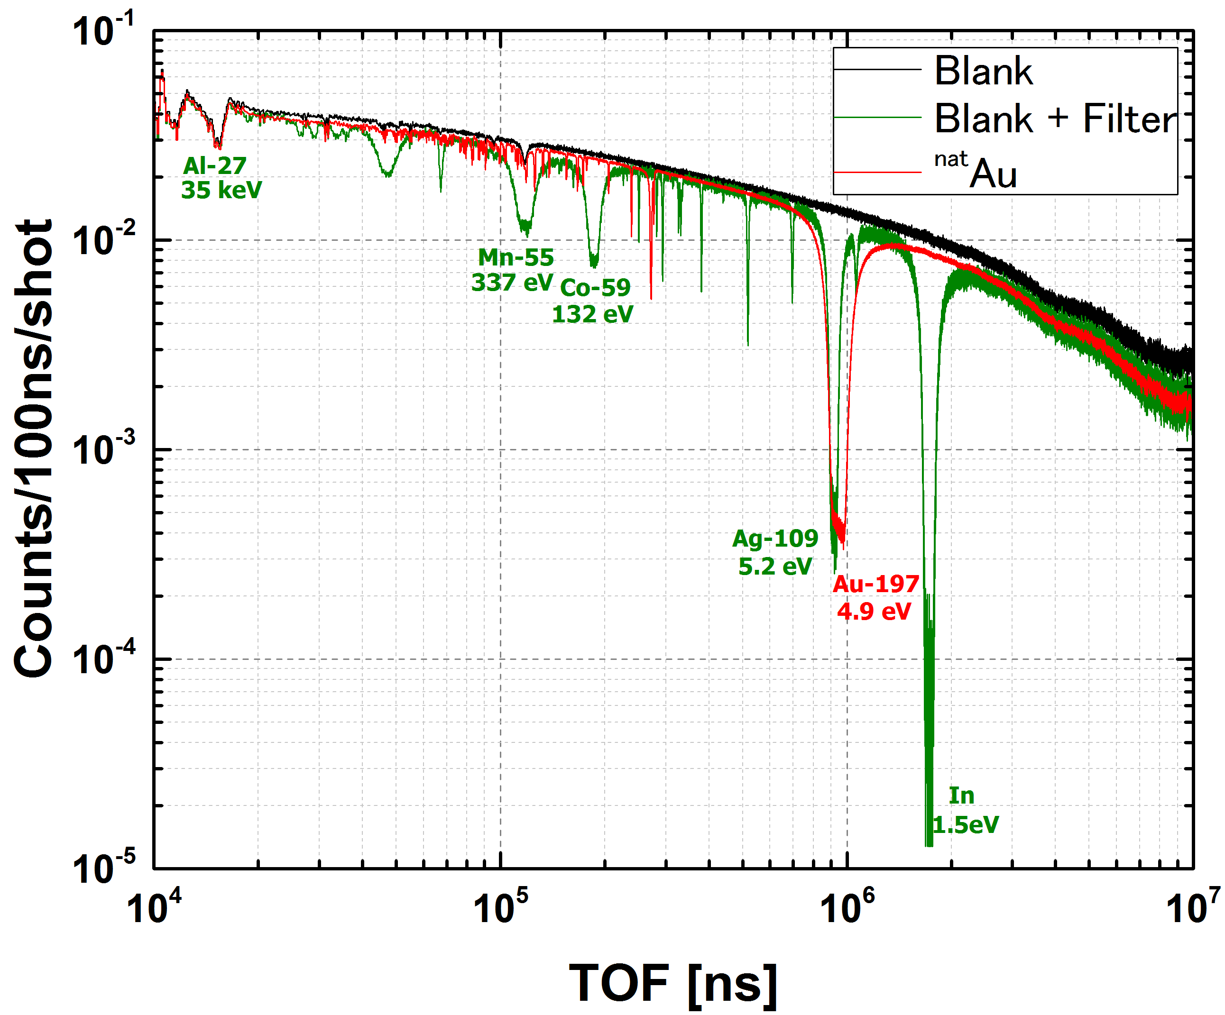
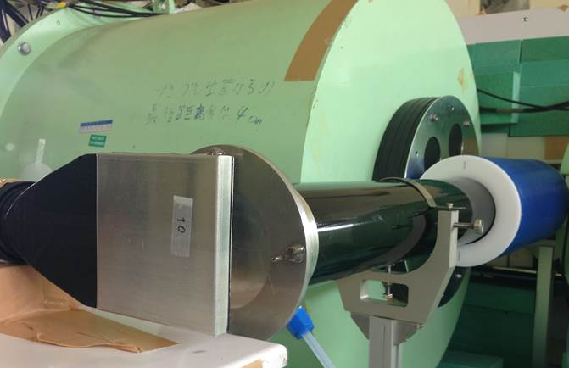
Measurement of neutron total cross sections
To determine the absolute value of the capture cross sections of MAs accurately, total cross section experimental setup combining capture measurement is under development.
Sample
Li-glass detector
Measurements of neutron total cross sections of ^{nat}Au and ^{nat}Ta have been performed to verify the reliability of the experimental system.
Data analysis is in progress.
GS20 Li-glass
(10cmx10cmx1cm)
TOF spectra for Blank (+Filter) and Au
experimental setup

Slide 7
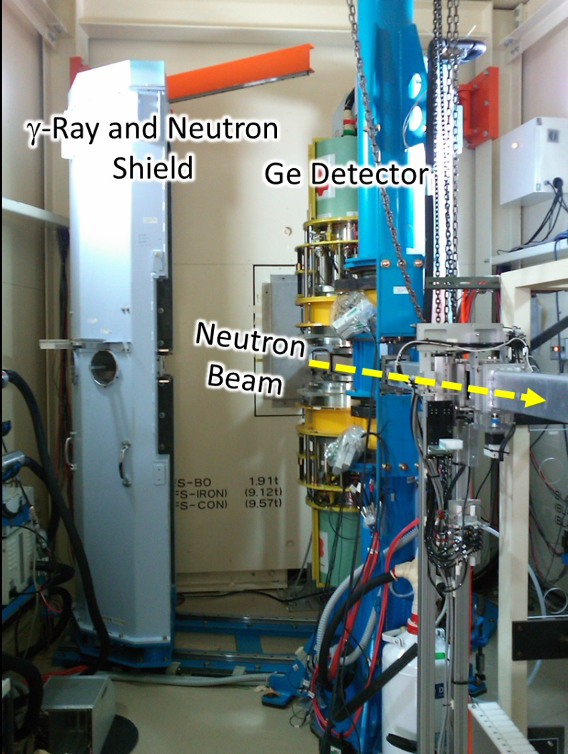
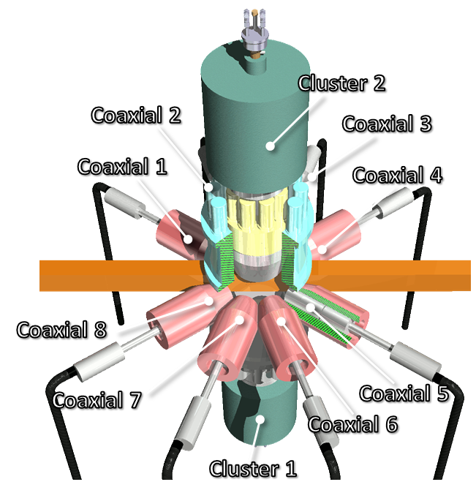
Measurements using Ge Spectrometer
Our spectrometer has
2 cluster-Ge detectors
(7 Ge crystals are installed in the detector)
8 coaxial-Ge detectors
Compton suppressing BGO detectors
⇒22 Ge Crystals.
Energy resolution for 1.33MeV γ-rays:
5.8keV (for 200kevents/s),
2.4keV (for 20kevents/s) [1]
Peak efficiency for 1.33MeV γ-rays:
3.64 ± 0.11 %
[1] T. Kin et. al., the 2009 NSS-MIC Conf. Rec. , N24-2, (2009).

Slide 8
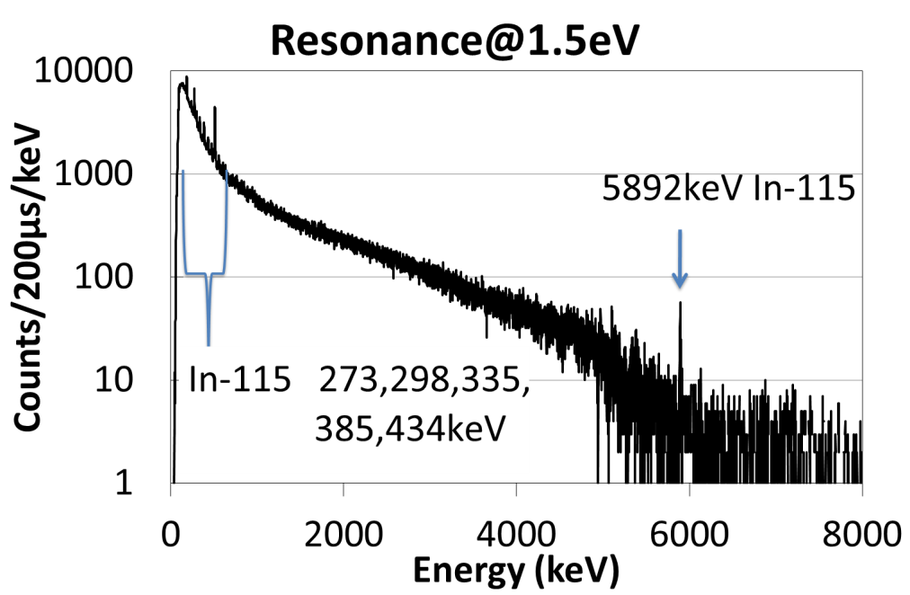
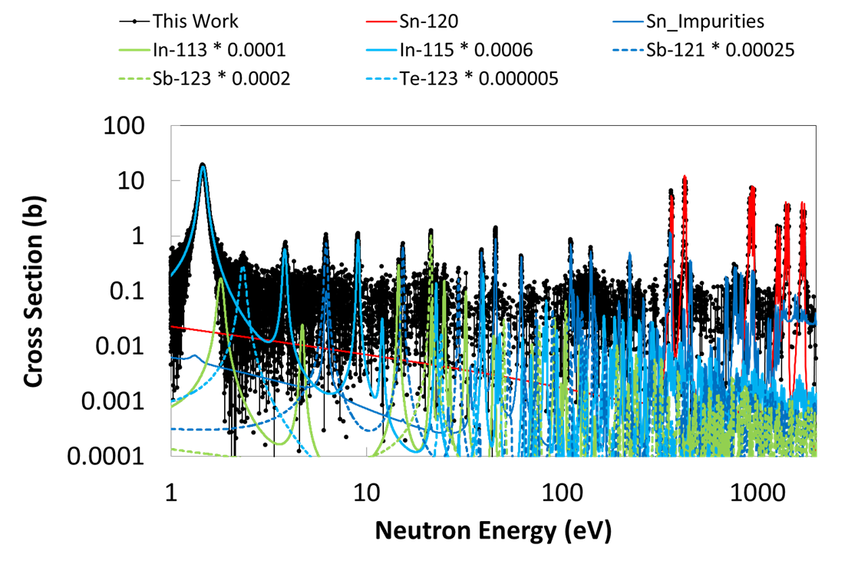
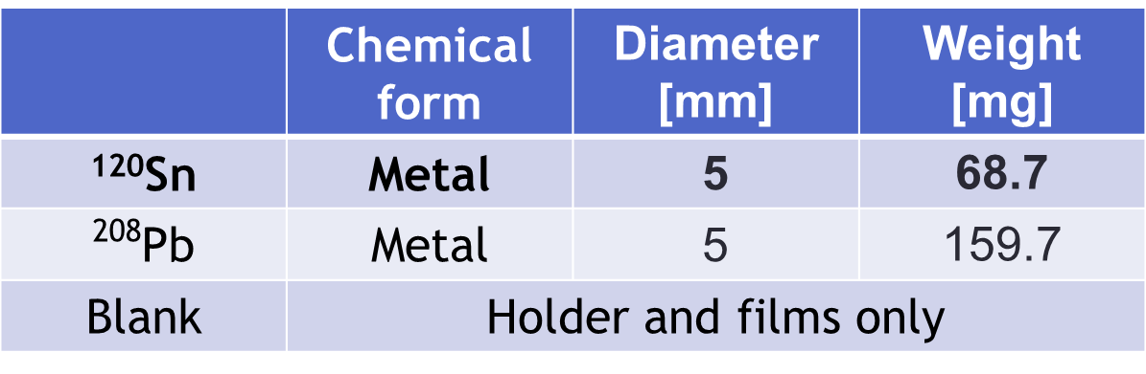
¹²⁰Sn(n, γ) cross section and resonance identification
Prompt γ-rays from ¹¹⁵In
were observed
-> The resonance at 1.5 eV is
not ¹²⁰Sn but ¹¹⁵In!
Sample
The spec sheet
Isotopic Distribution[%] ⇒
¹¹⁶Sn:0.12, ¹¹⁷Sn:0.1, ¹¹⁸Sn:0.3, ¹¹⁹Sn:0.4, ¹²⁰Sn:98.8, ¹²²Sn:0.15, ¹²⁴Sn:0.1
Chemical Impurities ⇒
B:40ppm, Sb:60ppm, Al:250ppm, Ca:200ppm, Fe:400ppm, Zn:350ppm, Si:600ppm
Note: “In” is not listed as impurities on the spec sheet.

Slide 9
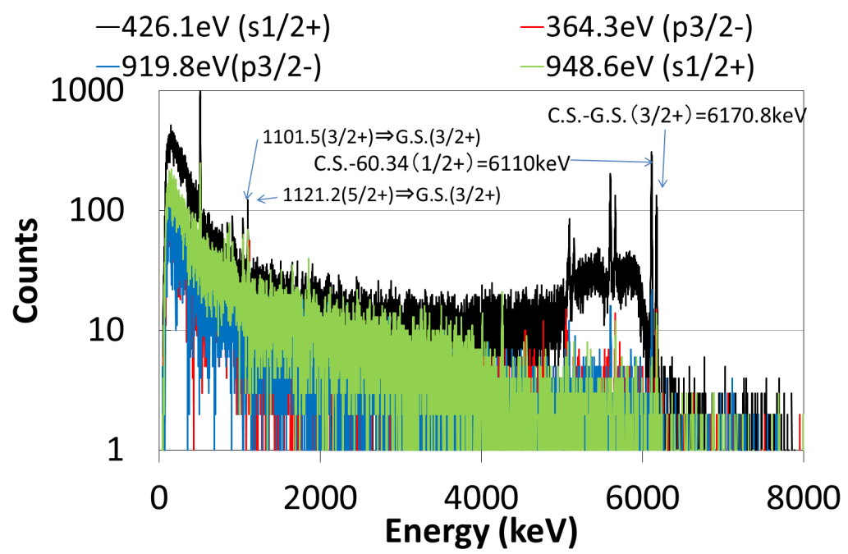
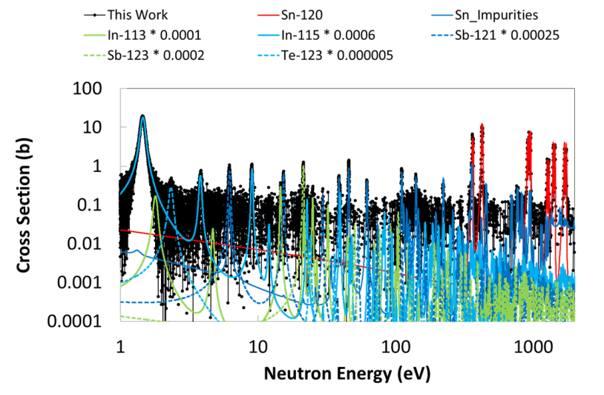
The prompt γ-ray distributions gated at ¹²⁰Sn resonances

Slide 10
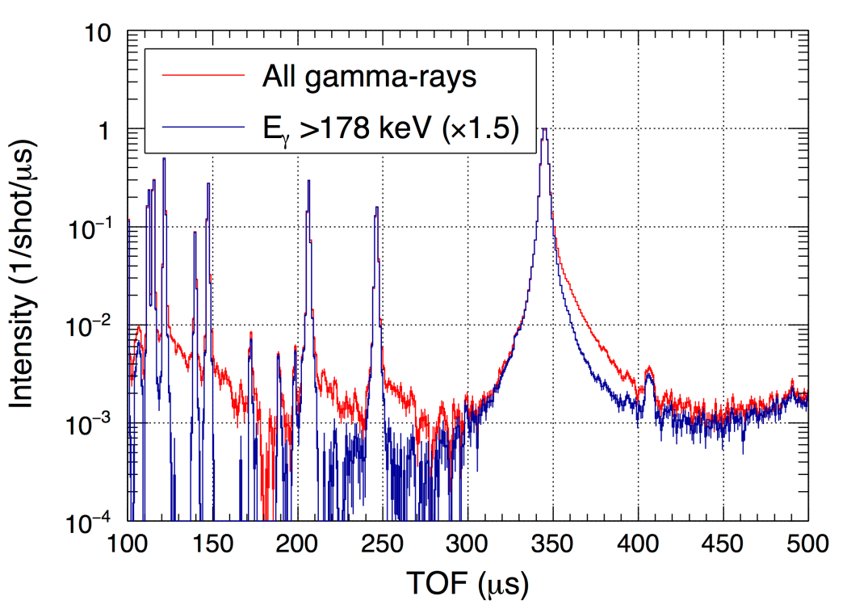
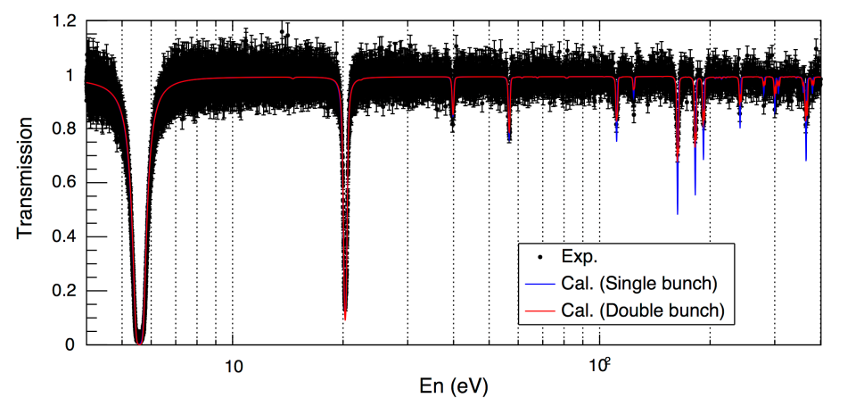
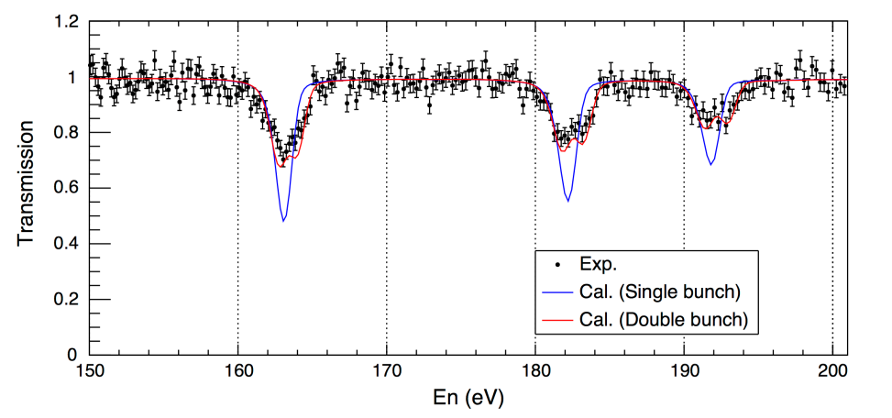
Neutron capture and total cross sections for Tc-99
Neutron capture reaction
Total reaction
Fig. 1 Effect of isomer rejection
There are two isomers in the Tc-100 levels, which decay to the ground state of Tc-100 through the 1st excited state (172keV) of Tc-100.
We excluded the isomer effect from the TOF spectrum by rejecting the 172 keV gamma-rays.
Fig. 2 Transmission spectrum with the calculation based on the JENDL-4
Transmission spectrum obtained using a Li-glass neutron detector was in agreement with the calculation based on the JENDL-4.

Slide 11
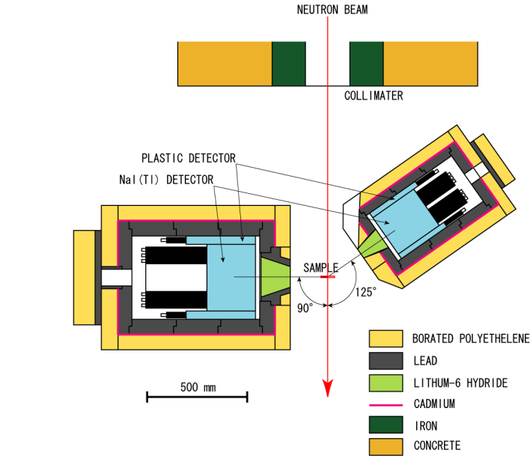
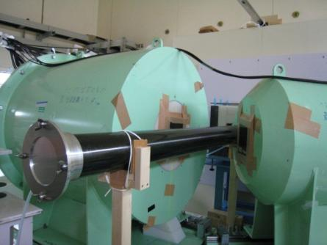
Measurements using NaI(Tl) Spectrometer
Use for:
  Complementary use to Ge array
  Measurement in the high energy range
Detectors
  90°detector: 13” diam. × 8” long
  125°detector: 8” diam. × 8” long
Shielding
  Borated polyethylene, Pb, ⁶LiH, Cd
Data acquisition
(T. Katabuchi)
  Multi-stop time digitizer
  TOF, pulse height, pulse width are recorded sequentially

Slide 12
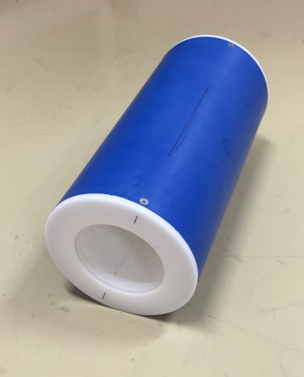
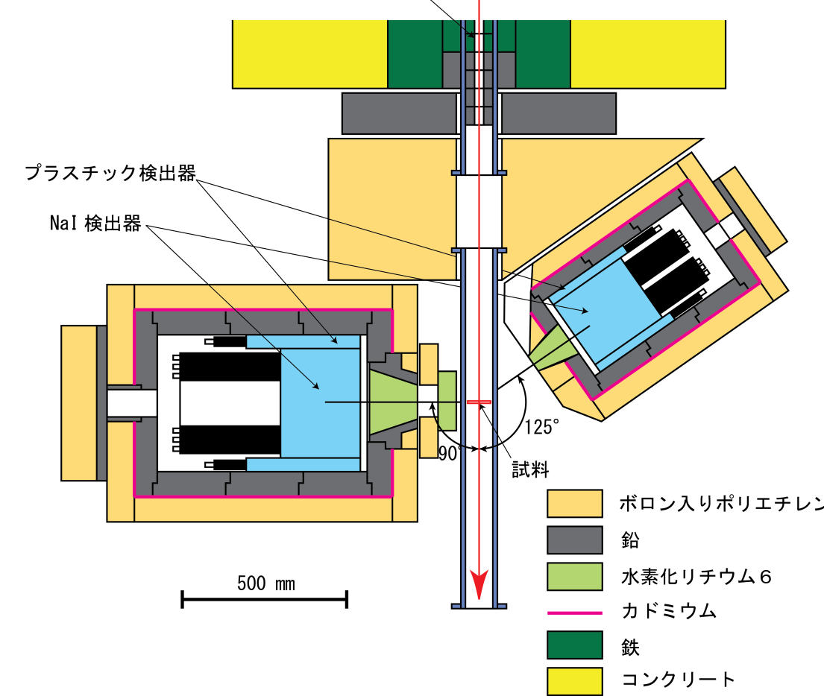
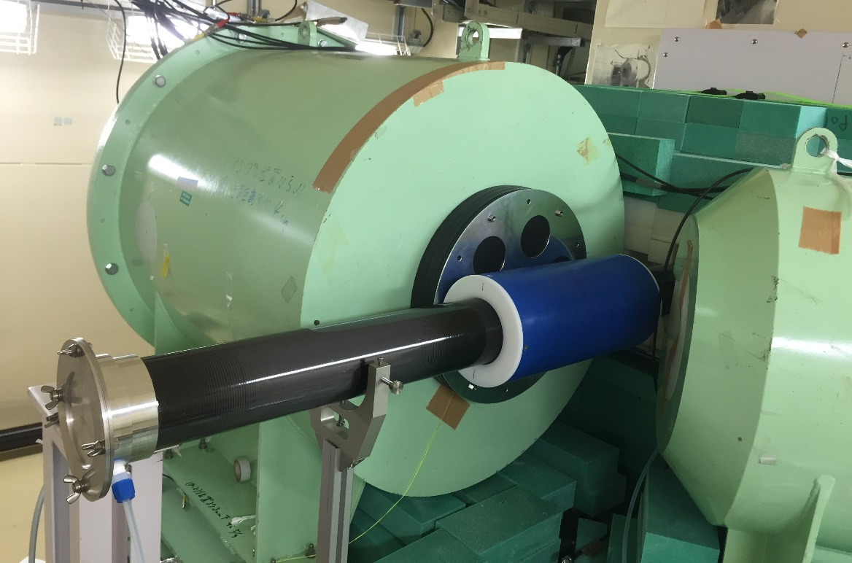
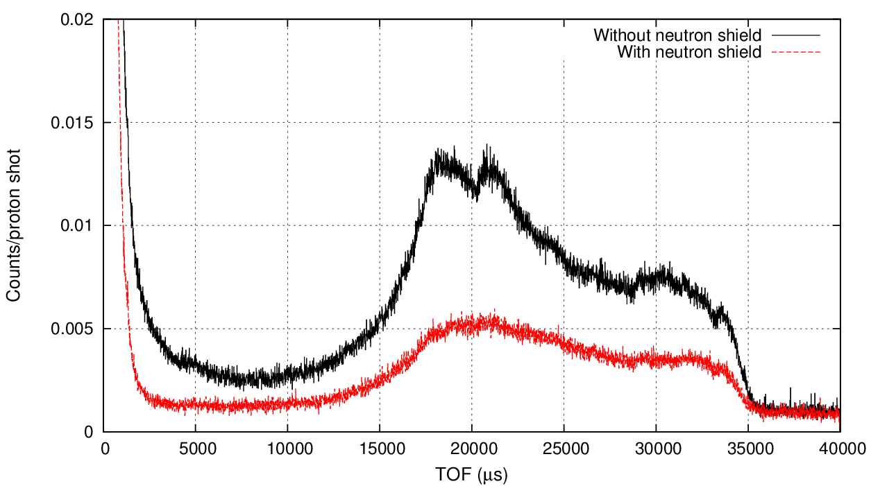
NaI(Tl) Detectors at ANNRI
Collimator
Neutron shield: ⁶LiCO₃
Neutron shield
Lead shield
Plastic Detectors
A new neutron shield was added in fiscal year 2014. Scattered neutron background was reduced.
NaI Detectors
Pb-208

Slide 13
Nuclear Data Activities at Tandem Accelerator Facility of
Japan Atomic Energy Agency
Contact :
Katsuhisa NISHIO
Advanced Science Research Center
Japan Atomic Energy Agency
nishio.katsuhisa@jaea.go.jp

Slide 14
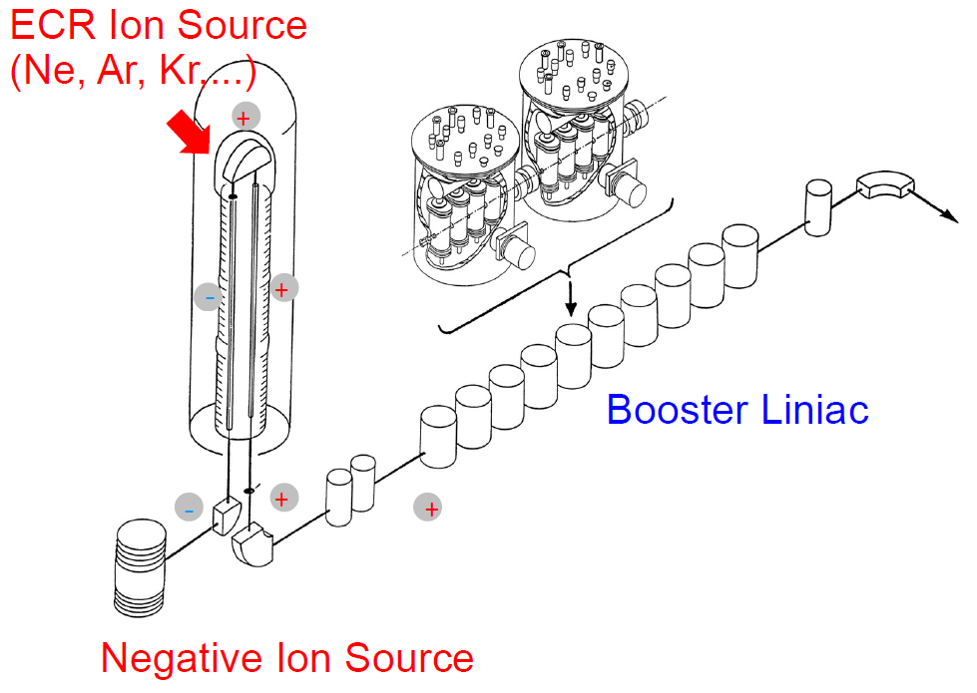
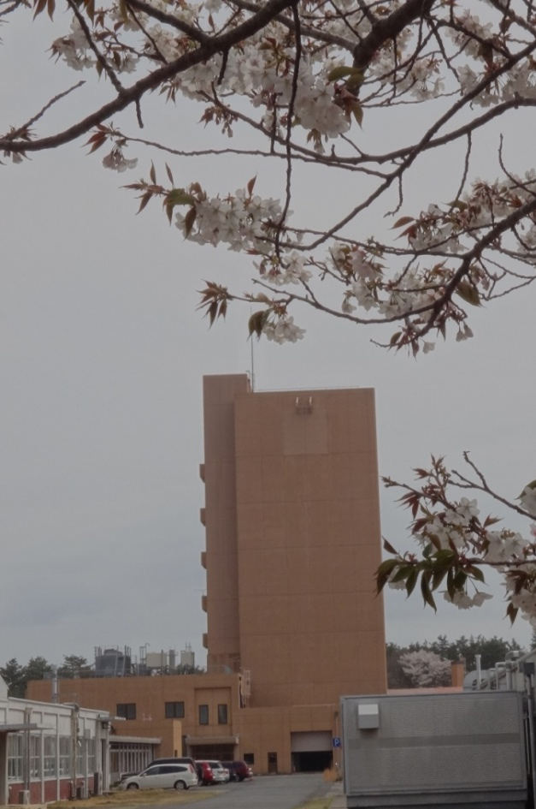
JAEA Tandem facility in Tokai
20 MV Tandem accelerator (20UR)
Super-conducting Booster Linac
ECR Ion Source on the terminal
Booster linac
Negative Ion Source

Slide 15
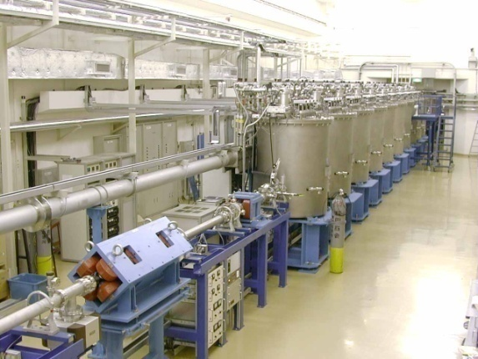
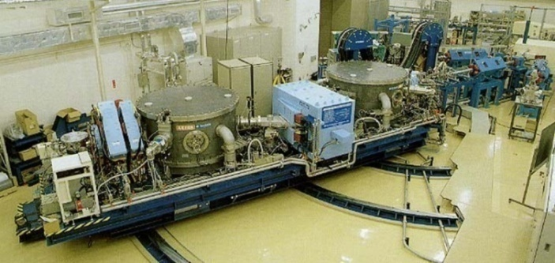
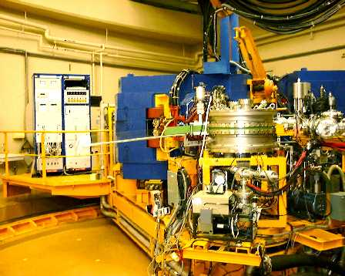
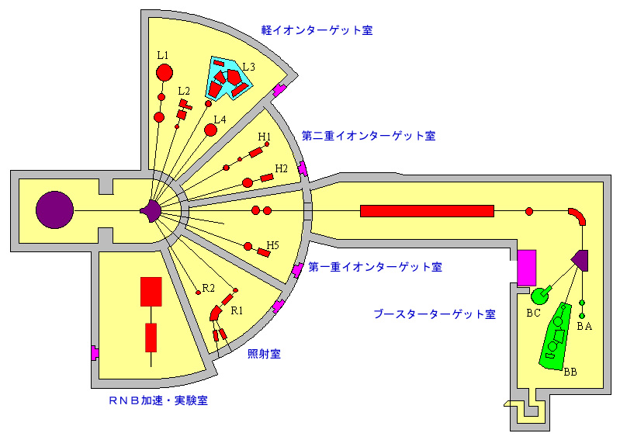
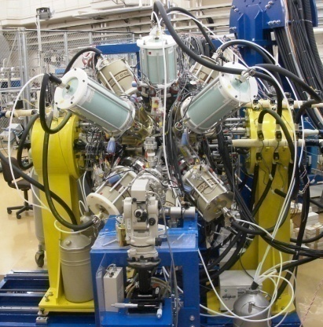
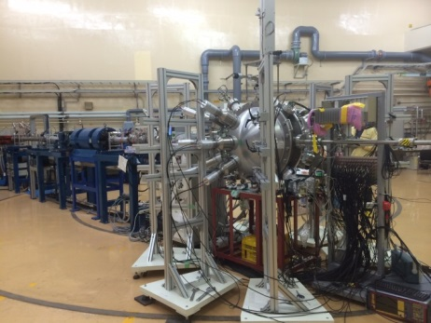
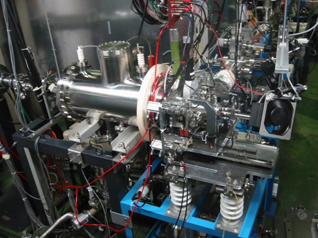
Booster Linac
Recoil Mass Separator
Magnetic Spectrometer
Ge-detector array
Surrogate/ fission / Reaction
ISOL
p + ²³⁸U & Gas-jet coupled
Radioactive materials can be used
Th, U, Np, Pu, Np, Am, Cm, Cf

Slide 16
Nuclear Data by Surrogate Reaction
Surrogate reaction
- Fission/Capture cross sections
- Fission fragment mass distribution
- Prompt neutron multiplicity
¹⁶O…
¹⁶O…
Surrogate Reaction
²³⁸U
Fragment 2
¹⁸O
CN
n
Prompt neutrons
²⁴⁰U*, …
Fragment 1
n
²³⁹U
(T_{1/2} = 23.5 m)
Desired Reaction

Slide 17
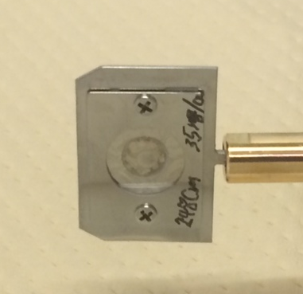
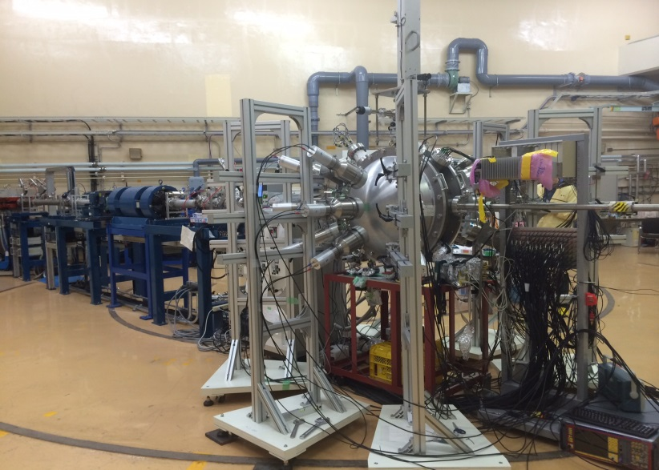
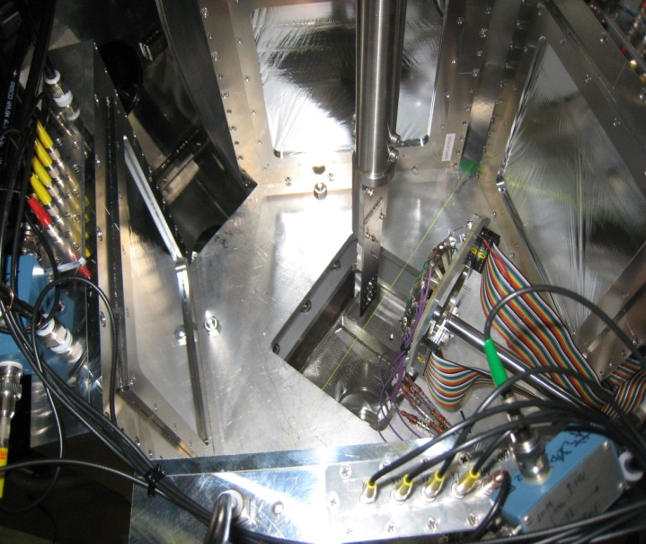
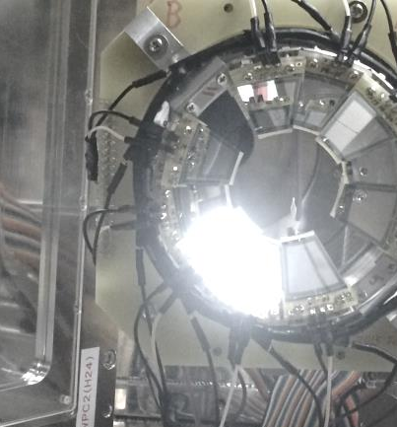
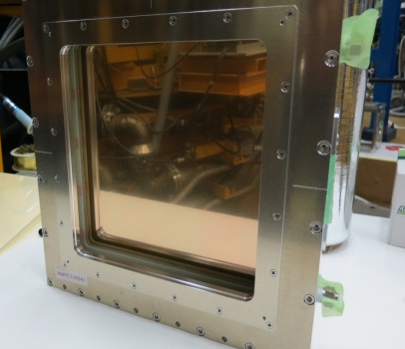
Beam Line for Surrogate/Fission Experiment
- Identification of transfer channels (Si ΔE-E)
- Fission fragments mass & angular distribution (MWPC)
- Prompt neutrons accompanied by fission (18 Liq. Scint.)
²⁴⁸Cm
Ø 2.0 mm, 1.5μg
Beam
Silion ΔE-E
(75μm + 300 μm)
Fragment 2
Target
Surrounded by
neutron detectors
Fragment 1
Ejectile
MWPC
200 x 200 mm²
Experimental Data Taken for ¹⁸O + ²³⁸U, ²³²Th, ²⁴⁸Cm
(under analysis)

Slide 18


Setup for multi-nucleon transfer induced fission
MWPC3
Target
¹⁶O...
MWPC1
¹⁸O
θ
Fragment 2
Recoil
ΔE = 75μm
¹⁸O Beam
θ
E = 300μm
ΔE-E
²³⁸U
²⁴⁰U*…
¹⁶O…
Fragment 1
φ
MWPC4
MWPC2

Slide 19
Particle Identification and Transfer Channel
¹⁸O + ²³⁸U (E_{beam}=157.5 MeV )
Pa
²³⁷⁻²⁴⁰U
²³⁹⁻²⁴²Np
F
²⁴¹⁻²⁴⁵Pu
Am
¹⁶⁻¹⁹O
¹⁴⁻¹⁷N
¹¹⁻¹⁵C
B

Slide 20
Fission Barrier
¹⁶O events
¹⁶O coincided with fragments
B_{f}
2nd
3rd

Slide 21

FF Mass Distributions and Neutron multiplicity
¹⁸O + ²³⁸U →^{19,18,17,16}O + ^{240,239,238,237}U*
¹⁸O + ²³⁸U →¹⁷N + ²³⁹Np*
New
Excitation
energy
²³⁷U
²³⁸U
²³⁹U
²⁴⁰U
²³⁹Np*
40-50 MeV
30-40 MeV
ν
Fission Yield (%)
20-30 MeV
Preliminary
10-20 MeV
Fragment Mass Yield (u)
Excitation Energy （MeV）

Slide 22
Activities at JAEA/FNS
IRDFF benchmark experiment
with DT neutrons at JAEA/FNS
Japan Atomic Energy Agency
Fusion Neutronics Group

Slide 23
Introduction
The new dosimetry cross-section data IRDFF (International Reactor Dosimetry and Fusion File) is a successor of IRDF-2002 and was released from IAEA in 2012.
We participated in IAEA CRP(Coordination Research Program) for benchmarking IRDFF in 2013.
  In 2014 we measured reaction rates of 40 reactions in IRDFF inside the graphite assembly, the neutron field in which is well specified in our previous benchmark experiment and has a lot of neutrons below 14 MeV including thermal neutrons.
  We just compare the measured reaction rates with calculated ones by using IRDFF data.
  We will validate IRDFF by March in 2017 under IAEA CRP.

Slide 24

Graphite assembly
Pseudo-cylindrical graphite (density : 1.64 g/cm³)
DT
neutron
source
9.6 cm
63 cmφ
20.3 cm
29.3 cm
61.0 cm
Experimental configuration

Slide 25

Results -1
Dosimetry reaction
Red : 9.6 cm
Green : 29.3 cm
0.6
0.8
1.0
1.2
1.4
Calc. / Expt.
C/E of reaction rates of reactions in IRDFF (part1)

Slide 26
Results -2
Dosimetry reaction
Red : 9.6 cm
Green : 29.3 cm
0.6
0.8
1.0
1.2
1.4
Calc. / Expt.
C/E of reaction rates of reactions in IRDFF (part2)

Slide 27

Results -3
Red : 9.6 cm
Green : 29.3 cm
Dosimetry reaction
0.6
0.8
1.0
1.2
1.4
Calc. / Expt.
C/E of reaction rates of reactions in IRDFF (part3)

Slide 28
Results -4
Dosimetry reaction
Red : 9.6 cm
Green : 29.3 cm
0.6
0.8
1.0
1.2
1.4
Calc. / Expt.
C/E of reaction rates of reactions in IRDFF (part4)

Slide 29
Activities at Radiation Science Center, KEK
Sanami and Hagiwara Group

Slide 30
Nuclear data measurement activities at
High Energy Accelerator Research Organization (KEK)
Light charged particle and fragment production DDXs
at intermediate energy region
Bragg curve counter is updated for simultaneous measurement of light charged particles and fragments with low energy threshold
Update
  Pre-amp unit is installed to reduce energy threshold
  SSDs are installed to measure longer range particles
Beam test
  Facility : Cyclotron, National Institute of Radiological Sciences, Japan
  Beam : 50 MeV proton
  Targets : Polypropylene-4 μm

Slide 31
Nuclear data measurement activities at
High Energy Accelerator Research Organization (KEK)
Beam: Ep=50MeV
Target : Poly (4 μm)
Particles: p,d,t,He
Fragments: Li, Be, B, C
were measured using single detector simultaneously

Slide 32
A Nuclear Reaction Data Program at RIKEN for FP in Nuclear Waste
H. Sakurai
RIKEN Nishina Center

Slide 33

Transmutation for LLFP : Motivation
Nuclear transmutation facility dedicated for nuclear waste of FP?
FP is dominant in nuclear waste
FP
46 kg FP / 1tU
1 kg TRU/ 1tU
total sum
Partitioning technique +
deep geological disposal
are being considered…
+Possible FP transmutation?
to minimize FP activities
neutron induced transmutation with
an accelerator system?
TRU sum
FP sum
activity (Bq)
year
Oigawa, JAEA

Slide 34



Transmutation for LLFP : The First Challenge
April, 2014
Beam species | Beam energy [MeV/u] | Intensity [/s/10pnA] | Purity [%]
¹³⁷Cs | 186 | 1200 | 14
⁹⁰Sr | 187 | 7100 | 28
ZeroDegree Spectrometer
PID for reaction products
to determine reaction
channels.
2ndary target
C, CH₂, CD₂
~200mg/cm²
Z
U-238 Acceleration
at Super-Conducting Cyclotron
PID at ZeroDegree
(n, Xn)
Fragmentation
Charge exchange
for p, d(n), C targets
A/Q
U-238 beam
Z
Inflight Separator BigRIPS
to deliver intense RI beams: Cs-137, etc
¹³⁷Cs
Be production
target
PID at BigRIPS
RIKEN, UT, Miyazaki, Kyushu, Hokkaido…
A/Q

Slide 35
Summary
We have lack of nuclear data for designing nuclear transmutation systems.
RIBF at RIKEN gives a unique opportunity to produce bunch of
nuclear data in inverse kinematics.
A pilot program w/ LLFP beams at 180 MeV/u has been organized successfully
with C, CH2 and CD2 targets.
The first data with p and d targets have been submitted for publication.
Reaction data with the other FP species and at different energies are
being obtained in the coming years.

Slide 36
Activities at Tokyo Institute of Technology (Tokyo Tech)
Igashira Group

Slide 37
Capture Cross Sections and
Gamma-ray Spectra in the keV Region
--------------------------------------------------------------------------
Nuclide En = 15 - 100 keV En = 550 keV
--------------------------------------------------------------------------
Y-89 2014/5 Not yet
Te-128 2014/7 Not yet
--------------------------------------------------------------------------

Slide 38

Experimental setup
3-MV Pelletron accelerator
Pulsed proton beam
  Repetition rate : 4 MHz
  Beam width : 1.5 ns
  Average current : 10 μA
Neutron source : ⁷Li(p,n)⁷Be
Flight path length :
  12 cm for 15-100 keV neutrons
  20 cm for 550 keV neutrons
NaI(Tl) Detector
Li Target
Sample
～
⁶Li –glass
Detector
～
4.7m
NaI(Tl) Spectrometer
Two Dimensional Data: TOF x PH
Notes:
This slide shows experimental setup.
We measured the capture cross sections and capture gamma-ray spectrum of ^{104, 105}Pd, using the 3-MV Pelletron accelerator of our laboratory.
These figure show the experimental setup .
We got pulsed proton beams from pelletron accelerator.
Repetition rate is 4MHz. Beam width is 1.5 nsec.
proton beams produce neutrons via the ⁷Li(p,n) reaction.
The incident neutron energy was measured by time-of-flight (TOF) method with a 6Li-glass detector.
The distance between the neutron source and the target was 12cm.
The capture gamma-rays emitted from the sample were measured with an anti-Compton NaI(Tl) detector.
The signals from the spectrometer were accumulated event by event as TOF data and Pulse Height data.
Next, I will describe the samples.

Slide 39
Capture Cross Sections and
Gamma-Ray Spectra of ⁸⁹Y

Slide 40
Activities at Kyoto University
KURRI Group

Slide 41

Integral experiment on MA neutron capture cross section using variable neutron flux fields in KURRI-LINAC
Motivation : Thermal neutron capture cross sections of MAs should be cross checked by integral measurements using variable neutron flux fields.
Research plan : As these neutron fields, Kyoto university’s critical assembly (KUCA) and electron linear accelerator (KURRI-LINAC) based neutron source are utilized. In this study, we constructed variable neutron fields in the KURRI-LINAC, and measured the neutron temperature of variable neutron flux fields using TOF and activation methods.
Table 1. Boric-acid concentration of the light water moderator and obtained neutron temperature
Present study is the result of “Research and Development for accuracy improvement of neutron nuclear data on minor actinides” entrusted to the Japan Atomic Energy Agency by the Ministry of Education, Culture, Sports, Science and Technology of Japan (MEXT).
Fig. 1 Measured neutron spectra of four types of neutron fields by TOF method

Slide 42
Nuclear production cross sections in intermediate energy region
Neutron-induced production cross sections are important as basic nuclear data.
1.Accelerator facility 2. Cosmochemistry 3. Nuclear chemistry
Measurement of production
cross sections of radionuclides
Reaction
^{nat}Cr (n, x)
⁸⁹Y (n, x)
¹⁵⁹Tb (n, x)
⁵⁹Co (n, x)
²⁰⁹Bi (n, x)
Beam
quasi-monoenergetic
neutron (Li(p,n))
E_{p}:several hundred MeV
Method
gamma-ray
spectrometry
by using HPGe
detector
The experiments are performed at Research Center for Nuclear Physics (RCNP)
of Osaka University, Japan.

Slide 43
Results
⁸⁹Y(n,x) reaction (S. Sekimoto et al., Nuclear Data Sheets 199(2014)197)
²⁰⁹Bi(n,x) and ⁵⁹Co(n,x) reaction (H. Yashima et al., Radiat. Prot. Dosim., 161, No.1-4(2014)139)
²⁰⁹Bi(n,4n)²⁰⁶Bi reaction
⁵⁹Co(n,3n)⁵⁷Co reaction

Slide 44

Activities at Konan University
Utsunomiya Group

Slide 45


Slide 46


Slide 47


Slide 48


Slide 49


Slide 50


Slide 51


Slide 52
Activities at Kyushu University
Watanabe Group

Slide 53


Systematic Measurement of Double-Differential Neutron Yields From Thick Target Irradiated by
Deuterons Below 10 MeV
Energy Engineering Physics Laboratory
Department of Advanced Energy Engineering Science
Kyushu University
In collaboration with Ishibashi Group in the Faculty of Engineering, Kyushu University
Notes:
In recent years, attention has been focused on deuteron accelerator-based neutron sources in various application fields such as boron neutron capture therapy (BNCT) and production of radioisotopes for medical use. Detailed information on neutrons generated in the target are required to determine accurately the neutron source term necessary for shielding design and radiation dose estimation. Carbon is one of the target material candidates. However, experimental data of double-differential thick target neutron yields (DDTTNYs) do not exist below 10 MeV. In the present work, we have been measuring the DDTTNYs for several targets at deuteron energies of 5MeV and 9MeV in order to meet these needs.

Slide 54


Experiment @KUTL
Thick target yield （TTY） data for R&D of deuteron accelerator-based neutron sources
Kyushu University Tandem Laboratory (KUTL)
  Deuteron energy : 9 MeV
Detector system
  NE213 scintillator (50.4 mm thick and 50.4 mm in diameter)
  Unfolding method with FORIST code
Target
  Ta with stopping length in FY2014
Measurement Angles
  0, 15, 30, 45, 60, 75, 90,
  120, 140 degrees
Notes:
The experiment was carried out at the Kyusyu University Tandem accelerator Laboratory (KUTL). The 5 and 9 MeV deuteron beams from the tandem accelerator were transported to a compact vacuum target chamber in the target room. An NE213 liquid organic scintillator 50.4 mm thick and 50.4 mm in diameter was adopted as a neutron detector. The detector was placed between 1.6 to 2.4 m from the target position depending on the measurement angle. Neutron yields from the target were measured at six angles of 0 to 140 degrees for 5 MeV, and nine angles of 0 to 140 degrees for 9 MeV. The target thickness was determined to stop the deuterons fully. The neutron energy spectra were obtained by means of an unfolding method with the response function of the NE213 scintillator because pulsed deuteron beams suitable for a time of flight method was not available at KUTL.
54

Slide 55


Result
Experimental double-differential thick target neutron yields from Ta at 9 MeV
Comparison of the measurement with PHITS calculation to validate the reaction models
d (9MeV) + Ta
PHITS cal.
The PHITS calculation using the intra-nuclear cascade of Liège (INCL) model underestimates the present experimental data remarkably. Systematic analyses of our 9 MeV data for C to Ta with PHITS and other model codes are now in progress.
Presented at 2015 Spring meeting of AESJ, Ibaraki Univ., Japan, Mar. 6-8, 2015.
Notes:
55

Slide 56
Activities at Kyushu University
Department of Applied Quantum Physics and Nuclear Engineering
Ishibashi and Shigyo Group

Slide 57
Neutron Production DDX from Heavy-Ion Interactions @ NIRS-HIMAC
Team:
Department of Applied Quantum Physics and Nuclear Engineering,
Kyushu University
Japan Atomic Energy Agency
Hiroshima University
High Energy Accelerator Research Organization
Shimizu Corporation
National Institute of Radiological Sciences
Korea Atomic Energy Research Institute
Contact:
Nobuhiro SHIGYO, Kyushu University

Slide 58


Neutron Production DDX from Heavy-Ion Interactions @ NIRS-HIMAC
Kyushu U., JAEA, Hiroshima U.,
KEK, NIRS, KAERI
Systematic cross-section data for
elements constituting a human
body’s tissue bombarded with
heavy-ion beams
HIMAC PH2 beam line
Beam: 430 MeV/u C, 630 MeV/u Ar
Target: C
Detection: NE213 (2 sizes) + TOF
Direction: 0˚, 15˚, 30˚, 45˚, 60˚, 75˚, 90˚
Data obtained down to 1 MeV of E_{n}
PHITS reproduces experimental data especially above tens MeV region
Shield
Target
Beam dump
NE213 detectors
Experimental setup at HIMAC
Preliminary
430MeV/u C(C, xn) DDX

