Slide 1

Progress on Methodology: Incorporating REWIND Weights in Adjustment Procedure
G. Palmiotti
Idaho National Laboratory
December 4, 2015
SG39, Paris, France

Slide 2
Outline
  Recall of REWIND (Ranking Experiments by Weighting for Improved Nuclear Data) methodology
  Incorporating REWIND weights in the adjustment formulation.
  Applying the new adjustment formulation to the case of the SG33 experiments and comparing results against those of standard formulation and REWIND PIA combined one.
  Conclusions and considerations for future work.

Slide 3
Progressive Adjustment Issue
The Kalman filtering technique is the algorithm at the base of the adjustment cross section adjustment. The original Kalman filter is applied separately to each measurement in a time series and it is naturally progressive, because time dictates the progressive adjustment.
Evaluators make a massive use of Kalman filter, but it is not clear how they prioritize the measurements to be used in a successive way.
The PIA (Progressive Incremental Adjustment) application has shown that the succession of experiments to be used in adjustment will impact significantly the final results both in terms of central values and a posteriori covariance.
The REWIND methodology was proposed in order to rank experiments by weight using a technique developed for optimizing portfolios of investment assets.

Slide 4
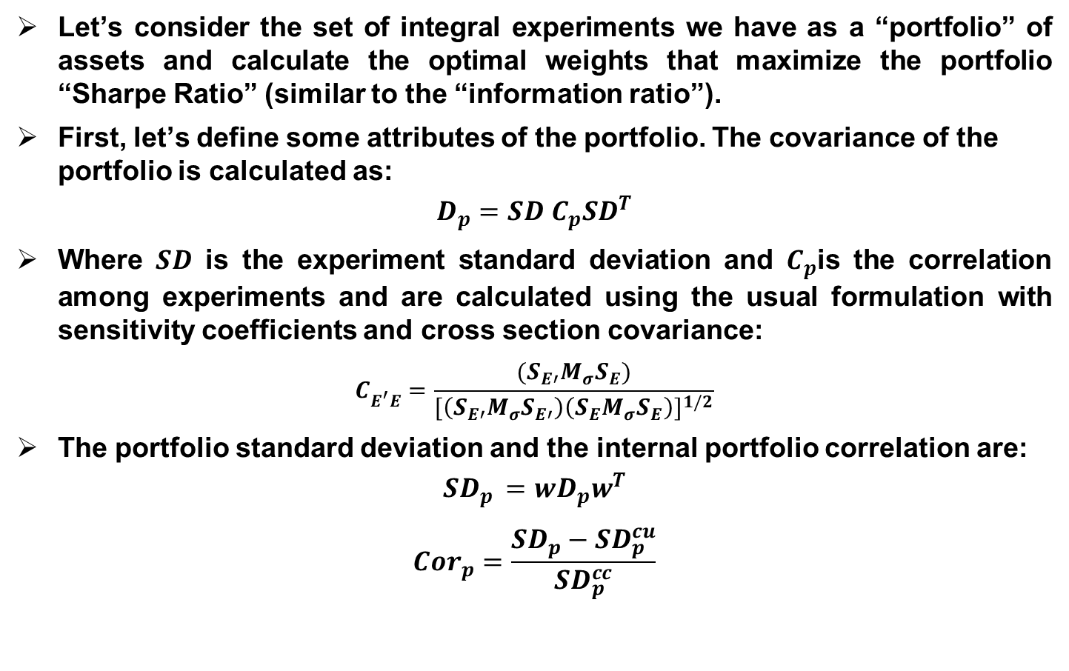
Application to Integral Experiments: REWIND
Let’s consider the set of integral experiments we have as a “portfolio” of assets and calculate the optimal weights that maximize the portfolio “Sharpe Ratio” (similar to the “information ratio”).
First, let’s define some attributes of the portfolio. The covariance of the portfolio is calculated as:
$$D_{p}=SD C_{p}{SD}^{T}$$
Where $SD$ is the experiment standard deviation and $C_{p}$is the correlation among experiments and are calculated using the usual formulation with sensitivity coefficients and cross section covariance:
$$C_{E^{′}E}^{}=\frac{(S_{E′}M_{σ}S_{E})}{{[\left(S_{E′}M_{σ}S_{E′}\right)\left(S_{E}M_{σ}S_{E}\right)]}^{1/2}}$$
The portfolio standard deviation and the internal portfolio correlation are:
$${SD}_{p }=wD_{p}w^{T}$$
$${Cor}_{p}=\frac{{SD}_{p}−{SD}_{p}^{cu}}{{SD}_{p}^{cc}}$$

Slide 5
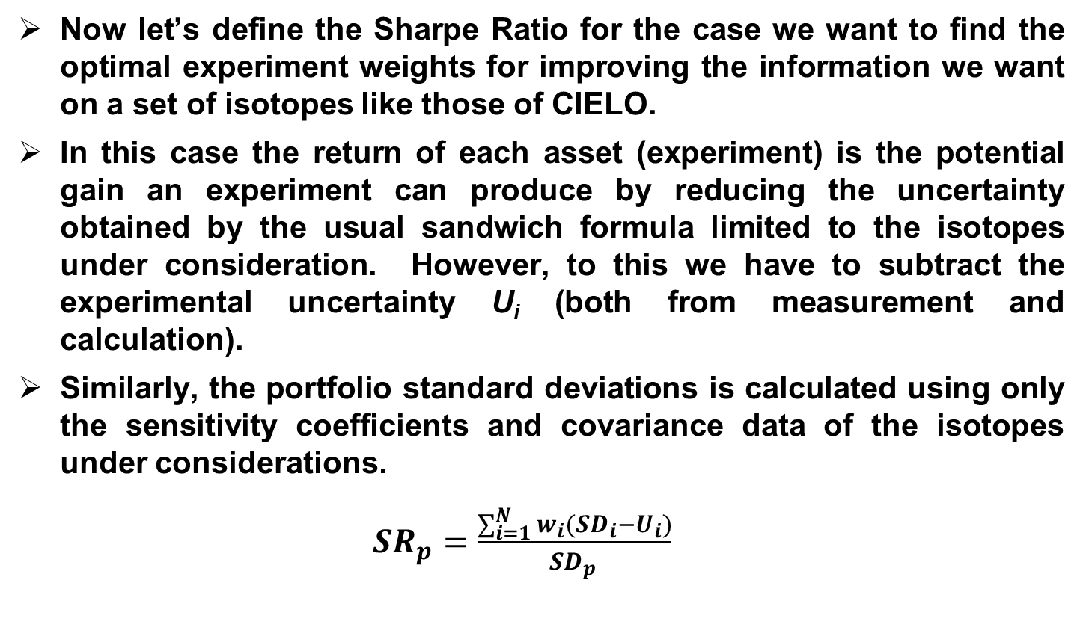
Application to Integral Experiments: REWIND
Now let’s define the Sharpe Ratio for the case we want to find the optimal experiment weights for improving the information we want on a set of isotopes like those of CIELO.
In this case the return of each asset (experiment) is the potential gain an experiment can produce by reducing the uncertainty obtained by the usual sandwich formula limited to the isotopes under consideration. However, to this we have to subtract the experimental uncertainty U_{i} (both from measurement and calculation).
Similarly, the portfolio standard deviations is calculated using only the sensitivity coefficients and covariance data of the isotopes under considerations.
${SR}_{p}=\frac{\sum_{i=1}^{N}{w_{i}{(SD}_{i}−U_{i})}}{{SD}_{p }}$

Slide 6
Application to Integral Experiments: REWIND
Note that the Sharpe Ratio for each experiment, defined in this way, is very similar to the Ishikawa factor.
In fact the Sharpe Ratio equal to zero corresponds to the Ishikawa factor equal to 1. Positive Sharpe ratio is what we want from an experiment (corresponding to the Ishikawa factor greater than one).
The optimization process maximizes this portfolio Sharpe Ratio in order to find the optimal weights, and, therefore we will obtain a ranking of the experiments.
Subsequently we can use this ranking to apply a progressive adjustment like in PIA; it has to be noticed that the optimization process will reward experiments that are not correlated.
If, instead, the adjustment is targeting a specific reactor design, the experiment return (gain) will be defined in the Sharpe Ratio as the reduction of uncertainty obtained using the representativity factor.

Slide 7
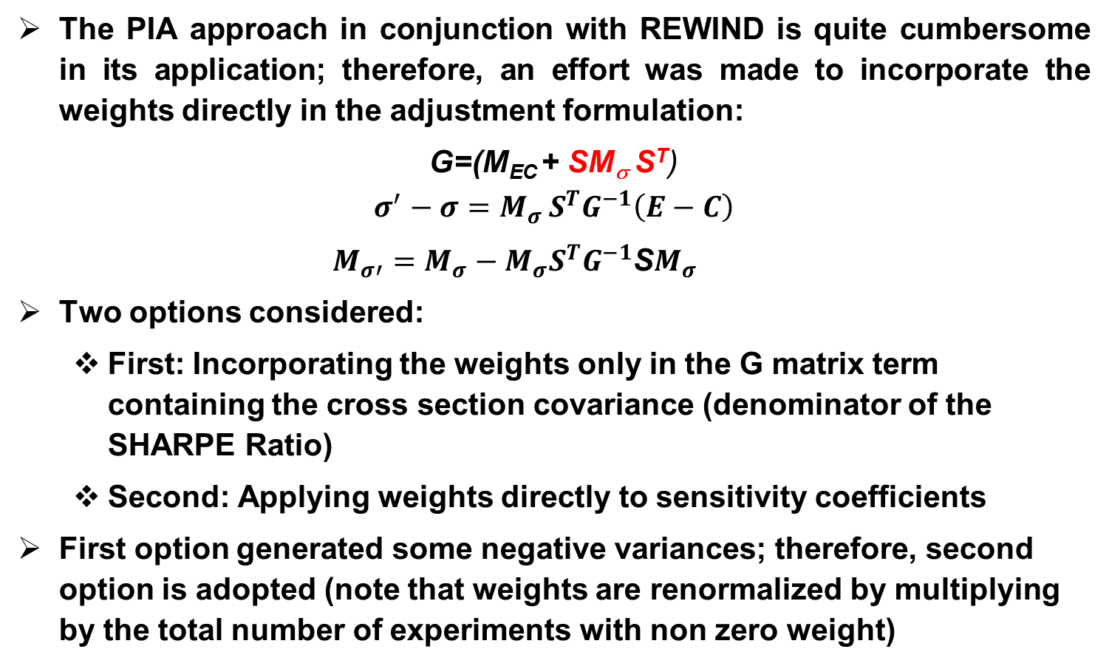
Incorporating REWIND Weights in Adjustment Formulation
The PIA approach in conjunction with REWIND is quite cumbersome in its application; therefore, an effort was made to incorporate the weights directly in the adjustment formulation:
G=(M_{EC} + SM_{σ} S^{T})
$$σ^{′}−σ=M_{σ }S^{T}G^{−1}\left(E−C\right)$$
$M_{σ′}^{}=M_{σ}−M_{σ}S^{T}G^{−1}$S$M_{σ}$
Two options considered:
  First: Incorporating the weights only in the G matrix term containing the cross section covariance (denominator of the SHARPE Ratio)
  Second: Applying weights directly to sensitivity coefficients
First option generated some negative variances; therefore, second option is adopted (note that weights are renormalized by multiplying by the total number of experiments with non zero weight)

Slide 8
Application to the SG33 Experiments
As shown at the past meeting, applying REWIND to the SG33 20 experiments portfolio generates weights different from zeros for only 7 experiments.
However, the ranking favors more global experiments than the elemental type one, and, therefore, it is not clear if compensations are avoided (the original aim of PIA).
Results have been compared against those of a standard adjustment and those where PIA is applied using the ranking following the weights calculated by REWIND.
Results indicated:
  Central values are practically equivalent for the three approaches
  Standard deviations are comparable, but using REWIND weights incorporated in the adjustments tends to produce higher standard deviations that the other two approaches.

Slide 9
REWIND applied to SG33 set of experiments and 5 Isotopes: ²³Na, ⁵⁶Fe, ²³⁵U, ²³⁸U, ²³⁹Pu
Experiment | Optimal weight % | Rank | Exp. Return % | Sharpe Ratio | Ishikawa Factor | Uncert. before adjust. % | Uncert. after adjust. %
JEZ_Pu239 KEFF | 27.8 | 2 | 0.45 | 0.69 | 1.50 | 0.30 | 0.15
JEZ_Pu239 F28/F25 | 3.4 | 6 | 2.26 | 0.61 | 1.18 | 1.68 | 0.90
JEZ_Pu239 F37/F25 | 5.0 | 5 | 0.91 | 0.39 | 0.71 | 1.02 | 0.64
JEZ_Pu239 F49/F25 | 0.0 | 8 | -0.13 | -0.15 | 0.85 | 0.80 | 0.53
JEZ_Pu240 KEFF | 0.0 | 8 | 0.29 | 0.59 | 2.44 | 0.49 | 0.18
FLATTOP KEFF | 38.1 | 1 | 0.56 | 0.65 | 0.92 | 0.28 | 0.16
FLATTOP F28/F25 | 0.0 | 8 | 1.22 | 0.40 | 0.84 | 1.56 | 0.84
FLATTOP F37/F25 | 0.0 | 8 | 0.60 | 0.30 | 0.69 | 0.98 | 0.63
ZPR6/7 KEFF | 0.0 | 8 | 0.76 | 0.77 | 1.84 | 0.42 | 0.12
ZPR6/7 F28/F25 | 0.0 | 8 | 2.97 | 0.46 | 0.63 | 2.19 | 1.41
ZPR6/7 F49/F25 | 0.0 | 8 | -1.70 | -2.07 | 0.29 | 0.72 | 0.57
ZPR6/7 C28/F25 | 0.0 | 8 | -1.17 | -0.78 | 0.47 | 1.26 | 0.90
ZPR6/7 PU40 KEFF | 0.0 | 8 | 0.77 | 0.78 | 1.92 | 0.42 | 0.12
ZPPR9 KEFF | 7.5 | 4 | 1.10 | 0.90 | 3.83 | 0.45 | 0.11
ZPPR9 F28/F25 | 3.3 | 7 | 5.10 | 0.64 | 0.81 | 2.37 | 1.53
ZPPR9 F49/F25 | 0.0 | 8 | -1.26 | -1.47 | 0.34 | 0.72 | 0.56
ZPPR9 C28/F25 | 0.0 | 8 | -0.45 | -0.29 | 0.64 | 1.27 | 0.90
ZPPR9 STEP3 | 0.0 | 8 | -0.18 | -0.02 | 0.70 | 5.44 | 3.93
ZPPR9 STEP5 | 0.0 | 8 | 2.26 | 0.23 | 0.91 | 6.87 | 4.88
JOYO KEFF | 15.0 | 3 | 0.70 | 0.79 | 1.67 | 0.30 | 0.14
Experiment Portfolio Internal Correlation: -0.02

Slide 10
REWIND applied to SG33 set of experiments σ

Slide 11
REWIND applied to SG33 set of experiments σ

Slide 12
REWIND applied to SG33 set of experiments σ

Slide 13
REWIND applied to SG33 set of experiments
Standard Deviation

Slide 14
REWIND applied to SG33 set of experiments
Standard Deviation

Slide 15
REWIND applied to SG33 set of experiments
Standard Deviation

Slide 16
REWIND applied to SG33 set of experiments
Standard Deviation

Slide 17
REWIND applied to SG33 set of experiments
Standard Deviation

Slide 18
Conclusions
The REWIND weights have been incorporated in the adjustment procedure.
Results compared against the standard methodology shows that there are not unreasonable consequences.
In the future this new methodology can be applied to the set of the comprehensive adjustment of ENDF/B-VII.0 with ~ 100 experiments
However, the ranking favors more global experiments than the elemental type one, and, therefore, it is not clear if compensations are avoided (the original aim of PIA).
The REWIND approach is general and specific more appropriate functionals can be considered in the optimization step in order to give priority to the elemental experiments. Suggestions are welcome (Cyrille De Saint Jean has suggested the Cook distance).

