Slide 1


A Stress Test on ²³⁵U(n, f) in adjustment
with HCI and HMI benchmarks
WU Haicheng
China Nuclear Data Center(CNDC) China Institute of Atomic Energy(CIAE) P.O.Box 275-41,Beijing 102413, P.R.China
E-Mail: haicheng@ciae.ac.cn

Slide 2
OUTLINE
Background
Method of stress test
3. Results and discussion
4. Summary

Slide 3
Background
In SG33 benchmark exercise, adjusted results for ZPR6-7 F49/F25, ZPPR9 F28/F25 and F49/F25 reaction ratios are getting worse (decreased), which is suspected to be compensation errors caused by missing essential constraints of ²³⁵U(n,f) in 1~10keV energy region.
A stress test on ²³⁵U(n,f) to identify compensation errors was suggested with critical benchmarks sensitive to ²³⁵U(n,f) in 1~10keV region.
Notes:
Pa, protactinium

Slide 4
2. Method of stress test
Case A (Sg33 benchmark exercise)
11 isotope
¹⁰B, ¹⁶O, ²³Na, ⁵²Cr, ⁵⁶Fe, ⁵⁸Ni, ^{235,238}U, ^{239,240,241}Pu
8 Reactions
(n, el), (n, inl), (n, disappearance),(n, f), Nu-total, Chi-p, Mu, Nu-delay.
Covariance: JENDL-4.0
20 Integral data
JEZEBEL-Pu239 (k_{eff}, F28/F25,F49/F25, F37/F25), -Pu240 (k_{eff}), FLATTOP-Pu (k_{eff}, F28/F25, F37/F25), ZPR-6/7 (k_{eff}, F28/F25, F49/F25, C28/F25), -High Pu240 (k_{eff}), ZPPR-9 (k_{eff}, F28/F25, F49/F25, C28/F25, Na void reactivity (Step 3, 5)), JOYO Mk-I (k_{eff}) .

Slide 5
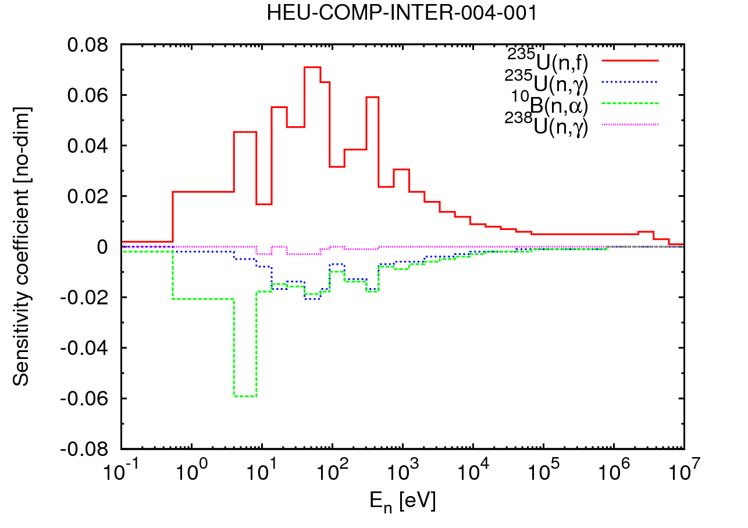
Case B (stress test 1)
The same isotopes, reactions and covariances
Integral data : + 1, HCI4.1 k_{eff} added.
HCI4.1 is a k_inf benchmark with intermediate spectrum. The benchmark model is an infinity HEU moderated with graphite.
HCI4.1 was design to provide a sensitivity test of ²³⁵U cross section over the energy range 10 eV to 10keV.
Sensi. Coeffi. for ²³⁵U(n,f), ²³⁵U(n,γ), ¹⁰B(n,α) and ²³⁸U(n,γ) were used in calculation.
Note: S.C. of HCI4.1 is not most sensitive benchmarks on 1~10keV region in ICSBEP.
Notes:
the HCI4.1 experiment consisted of sample reactivity worth measurements. The measured reactivity worth for a number of fuel samples with varied boron content were interpolated to produce a boron/235U ratio which would yield a k_inf of unity.

Slide 6
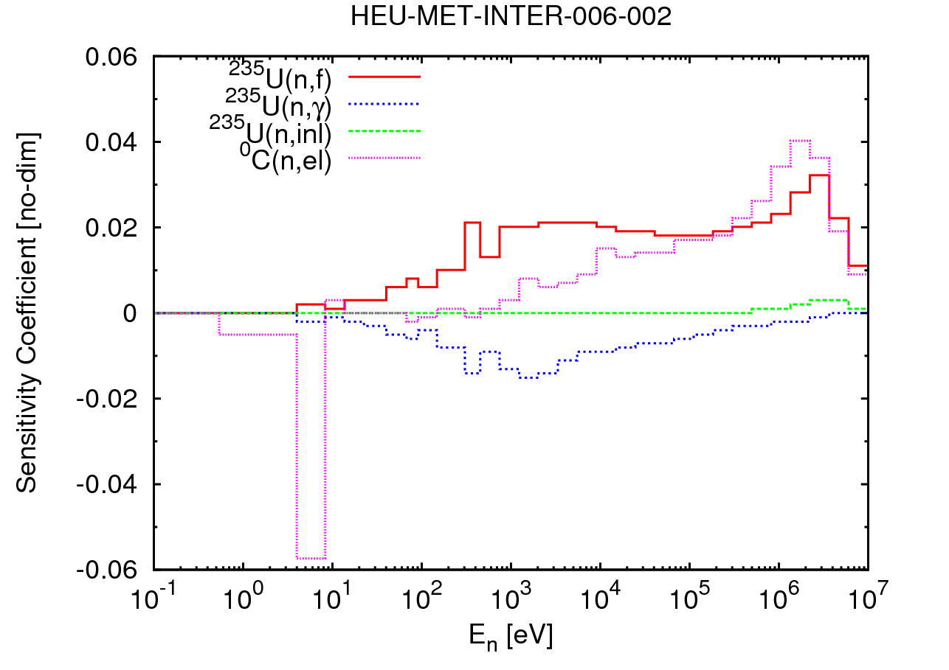
Case C (stress test 2)
The same isotopes, reactions and covariances
Integral data : + 2, HCI4.1 and HMI6.2 k_{eff} added.
HMI6.2 is an intermediate-spectrum critical assembly with a graphite-HEU core surrounded by a copper reflector.
Sensi. Coeffi. for ²³⁵U(n,f), ²³⁵U(n,γ), ¹⁰B(n,α) and ²³⁸U(n,γ) were used in calculation.

Slide 7
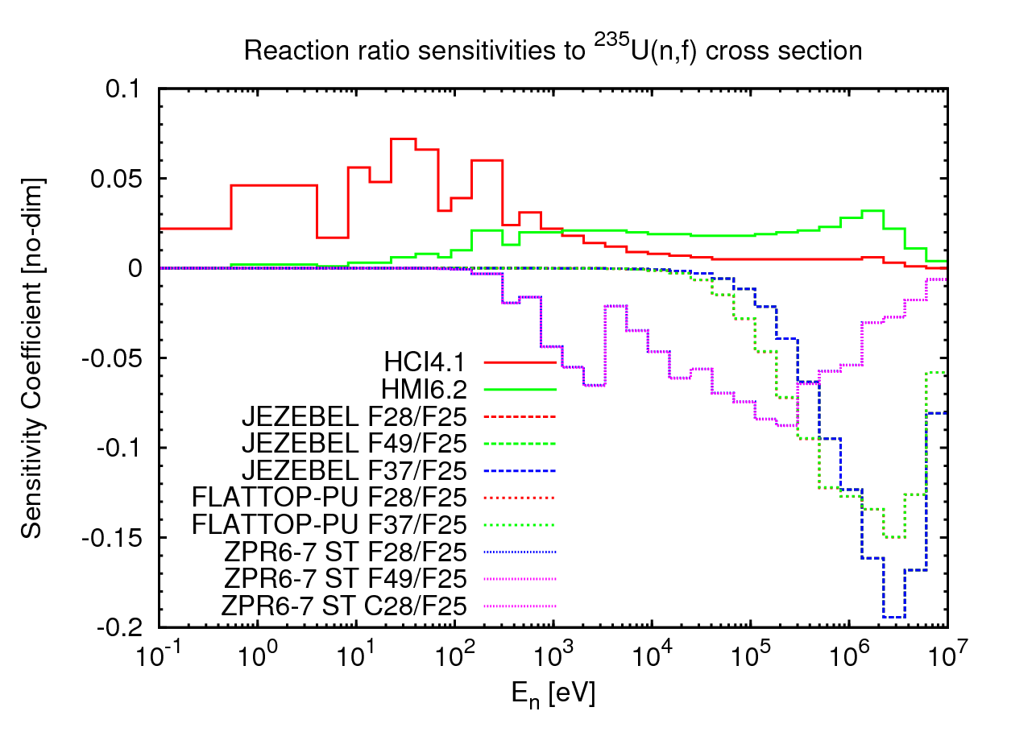
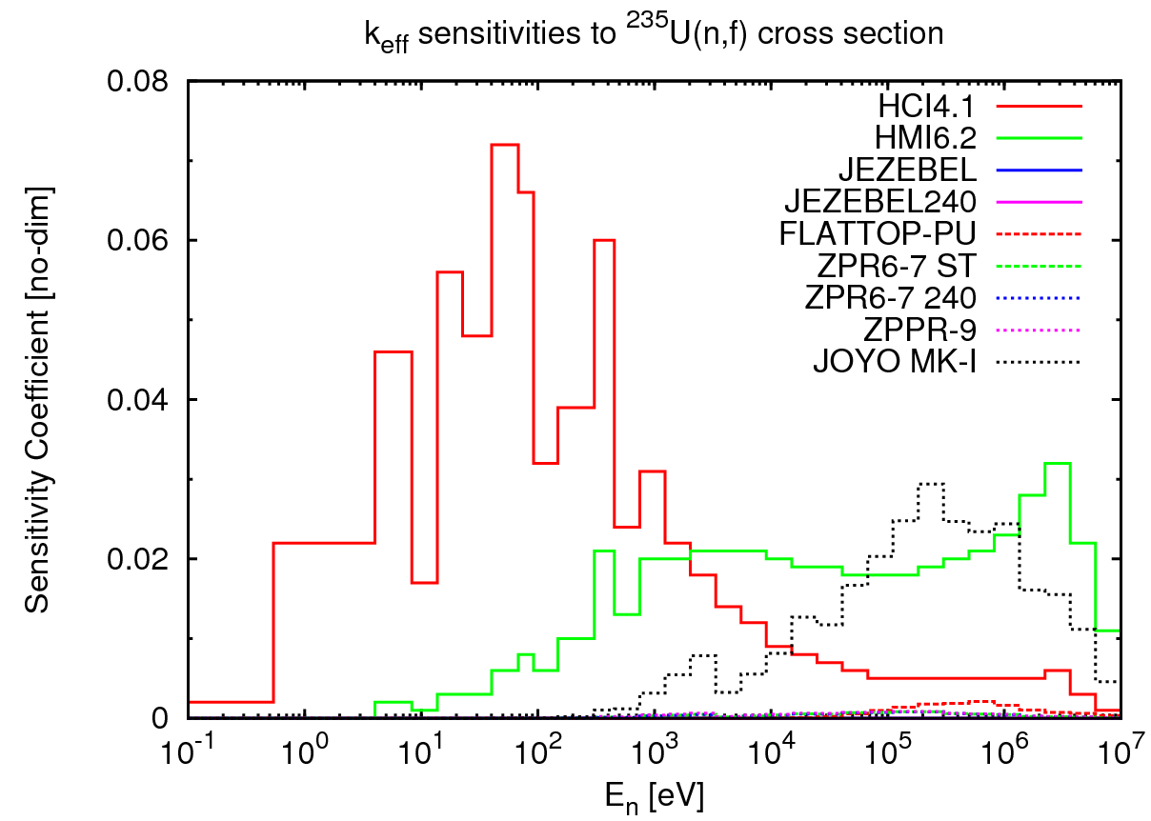
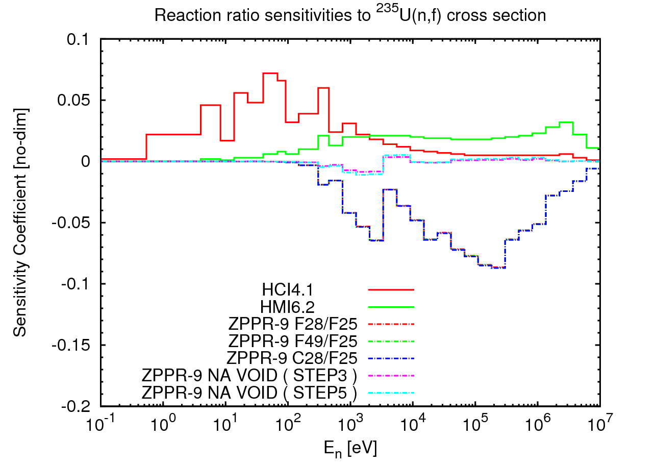
Sensitivities to ²³⁵U(n,f) cross section
Joyo MK-I is the only benchmark selected by SG33, whose k_{eff} is rather sensitive to ²³⁵U(n,f) XS in 1~10keV energy region than others.

Slide 8
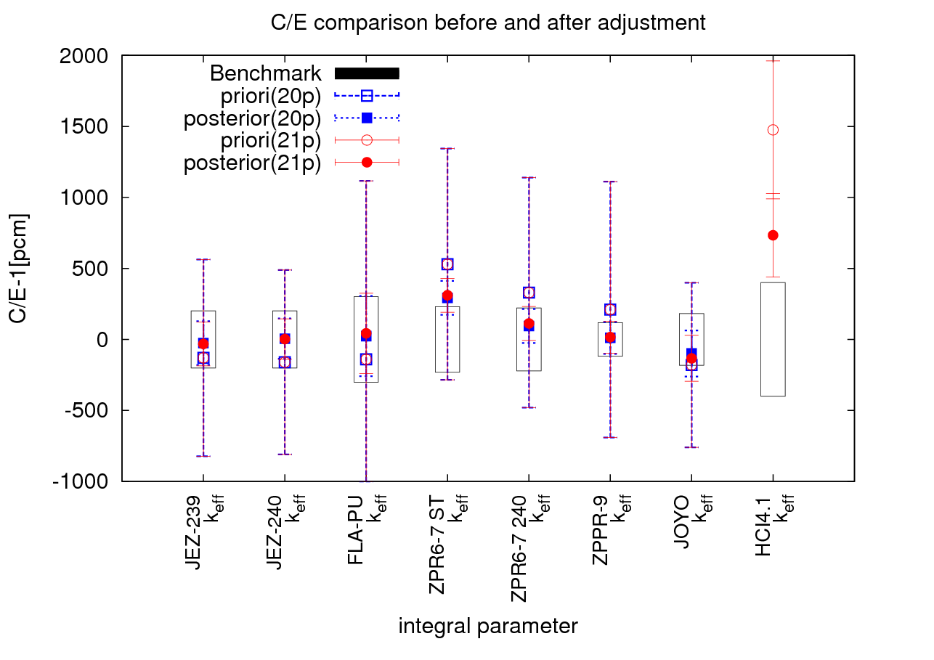
3. Results and discussion
Case A (20p) vs. Case B (21p)
The improvement of k_{eff} values for SG33 cases are almost the same.

Slide 9
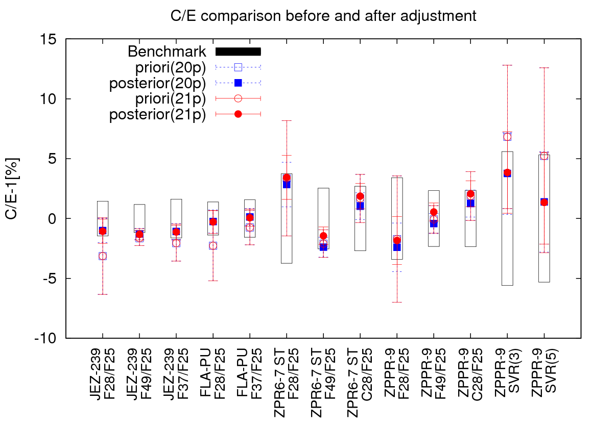
Different constraint gives different direction of adjustment.
Reaction ratio were increased in case B instead of decrease
in case A.

Slide 10
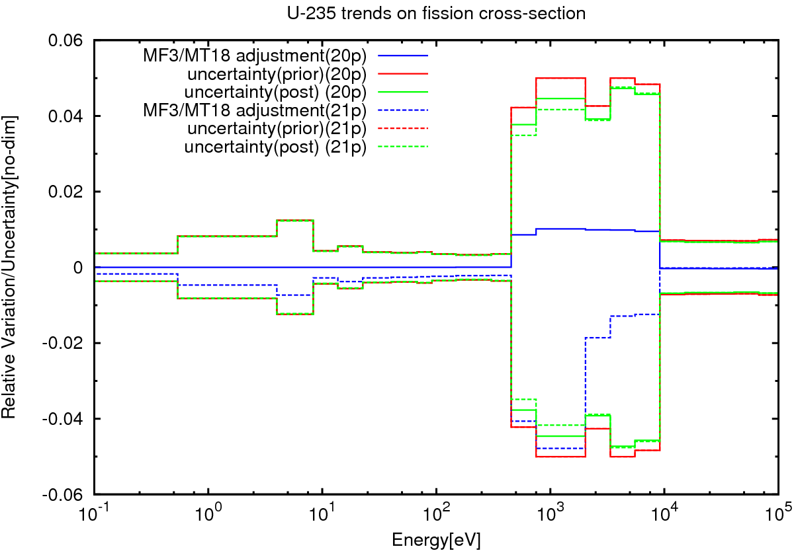
To improve the k_{eff} of HCI4.1, ²³⁵U(n,f) cross sections around 1 ~10keV were decreased in Case B instead of increased in case A.
Different constraints can even lead to contrary direction of adjustment.
Notes:
In this case, the change of ²³⁵U(n,f) cross sections were driven by sensitivity of HCI004_1.

Slide 11
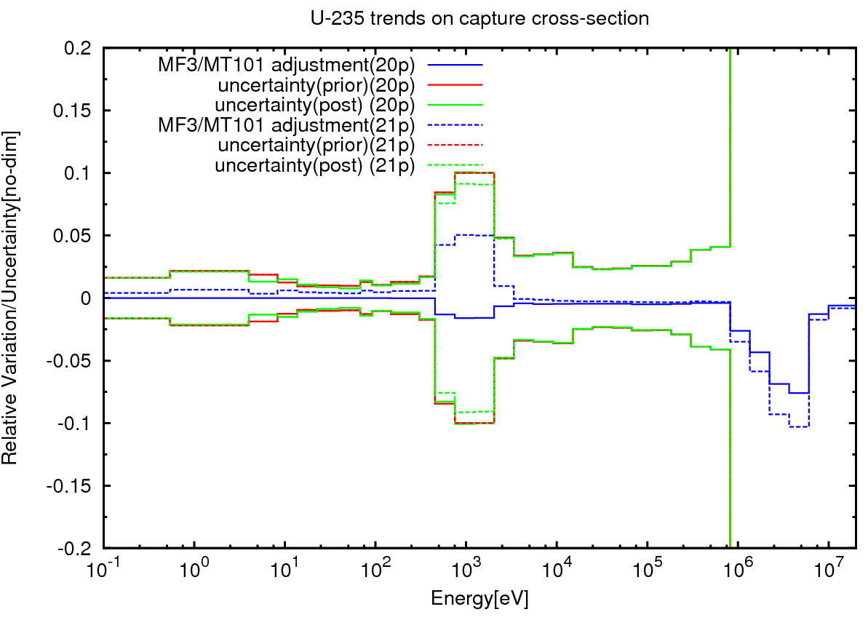
To improve the k_{eff} of HCI4.1, ²³⁵U(n,γ) cross sections around 1 keV were increased in Case B instead of decreased in case A.

Slide 12
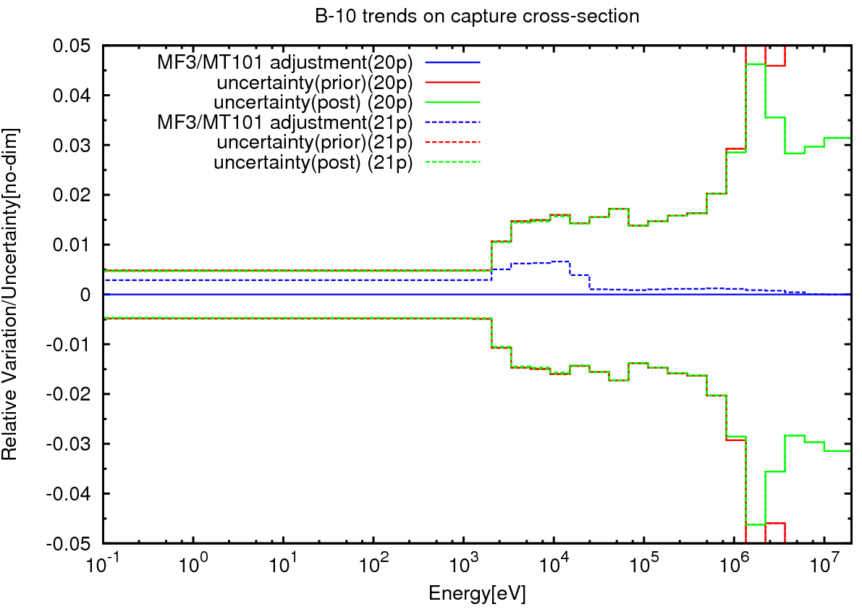
To improve the k_{eff} of HCI4.1, ¹⁰B(n,α) cross section increased 0.1~0.6% < 1MeV.

Slide 13
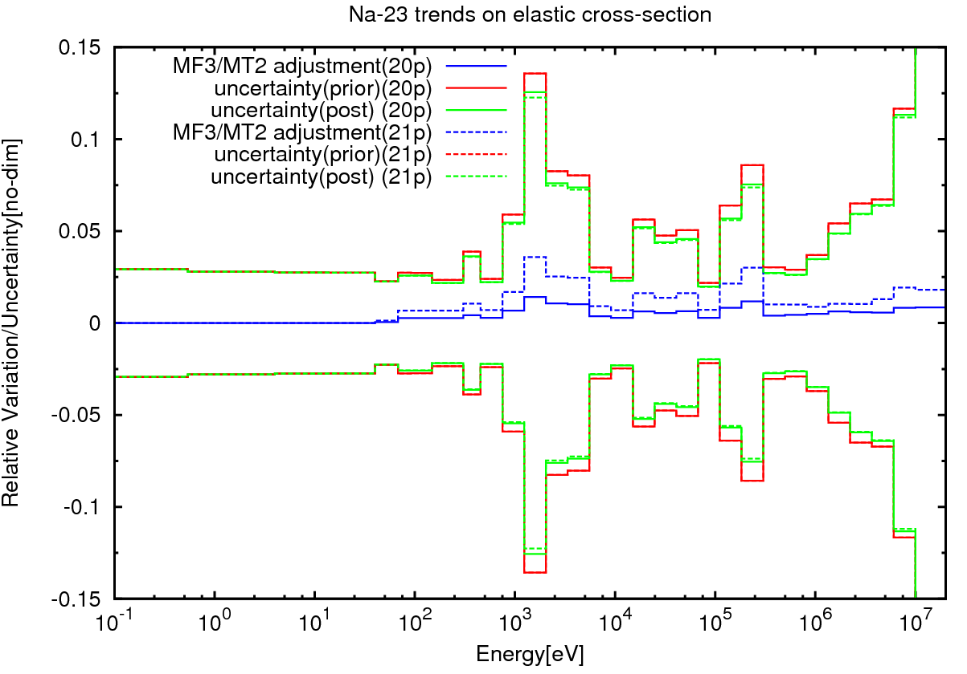
SVR results of ZPPR-9 were not change. Influence of ²³⁵U data change is compensated by others, such as
²³ Na(n,el).

Slide 14
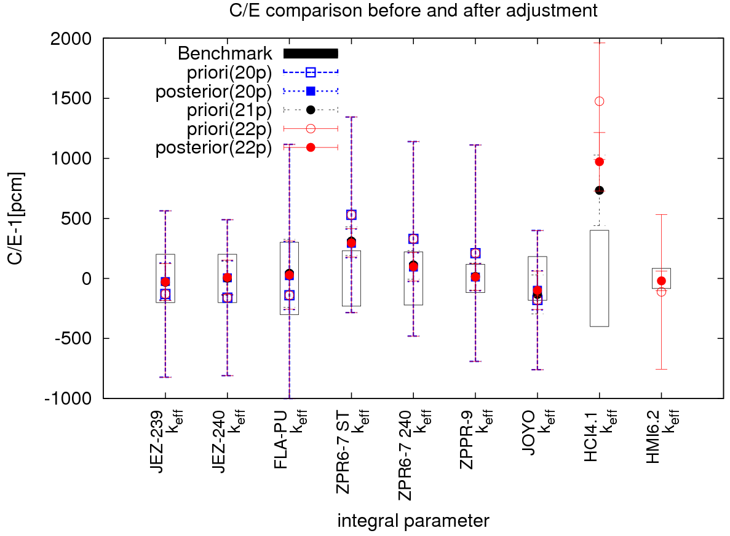
Case A (20p) vs. Case B (21p) vs. Case C (22p)
The improvement of k_{eff} values for SG33 cases are almost the same.
The new adjusted k_{eff} of HCI4.1 get worse than case B.
Notes:
In following figures, 21p indicate case B, 22p indicate case C.

Slide 15
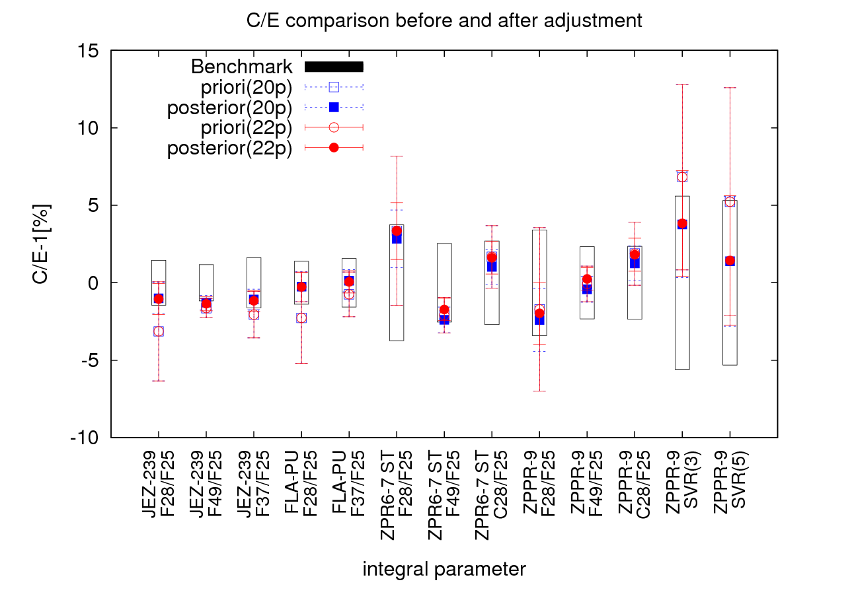
The adjusted reaction ratio in case C still a litter
higher than those in case A.

Slide 16
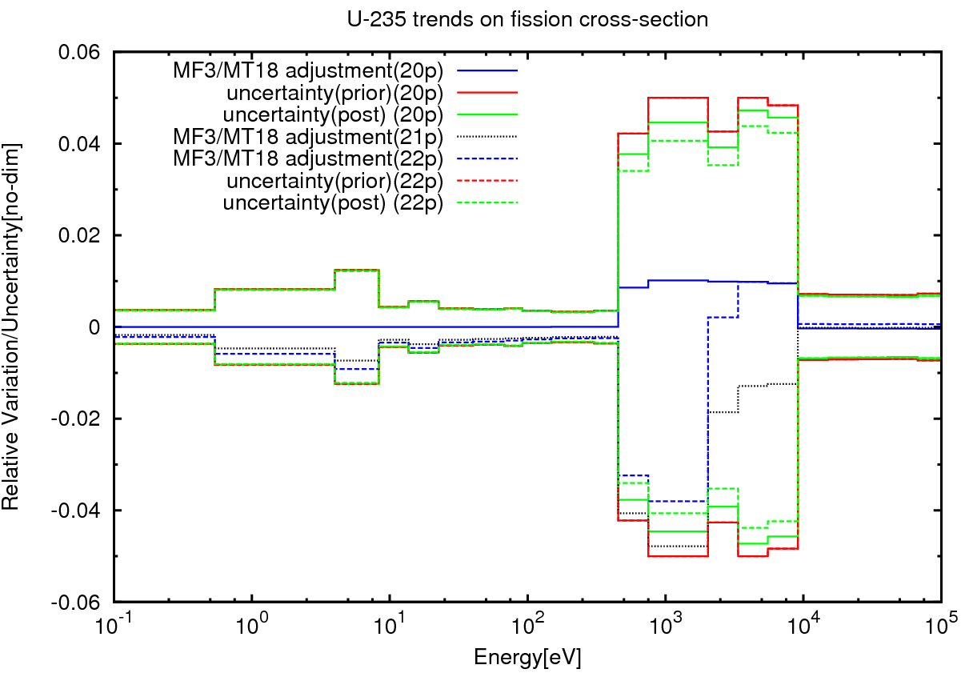
To improve the k_{eff} of HCI4.1, ²³⁵U(n,f) cross sections were decreased between 0.5~2keV but increased between 2~10keV in Case C, which is not completely agree with case B.

Slide 17
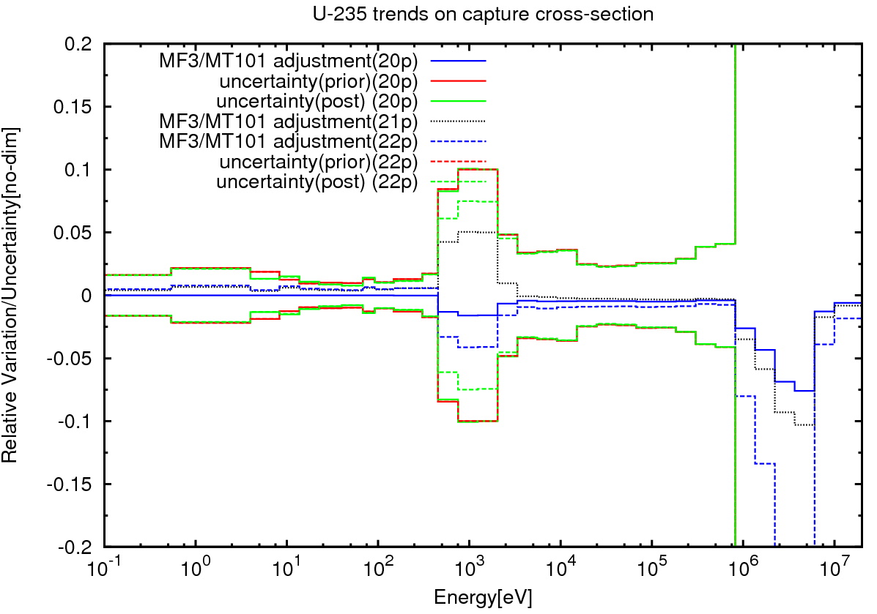
To keep the k_{eff} of HMI6.2 good, ²³⁵U(n,γ) cross sections around 1 keV were decreased 2% in Case C instead of increased 5% in case B.

Slide 18
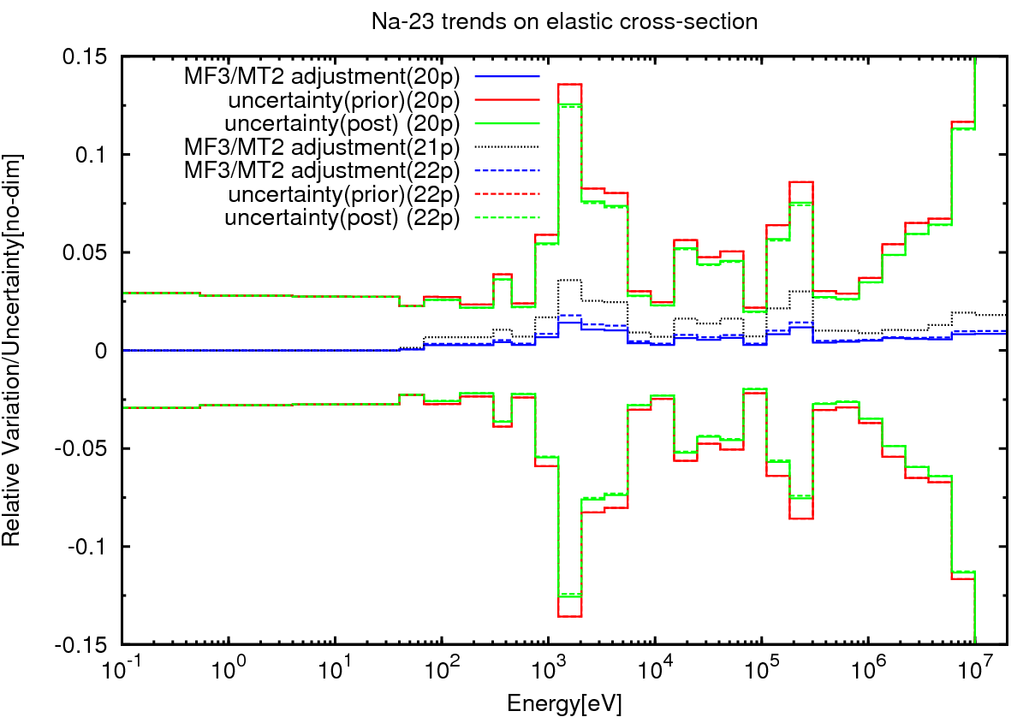
SVR results of ZPPR-9 were not change. Influence of ²³⁵U data change is still compensated by others, such as ²³ Na(n,el). But change of ²³ Na(n,el) get smaller.

Slide 19
4. Comments
Missing essential constraints will lead to compensation errors.
Different constraints can lead to different, even contrary adjustments for both integral and differential data.
To avoid compensation error and make adjusted nuclear data for general purpose, we need complete constraints.
Global adjustment of library needs global constraints which we don’t have yet.
Even to obtained adjusted library not for general purpose, construct of constraints still needs to be careful.
Different constraints (Such as benchmarks) give different library.

Slide 20
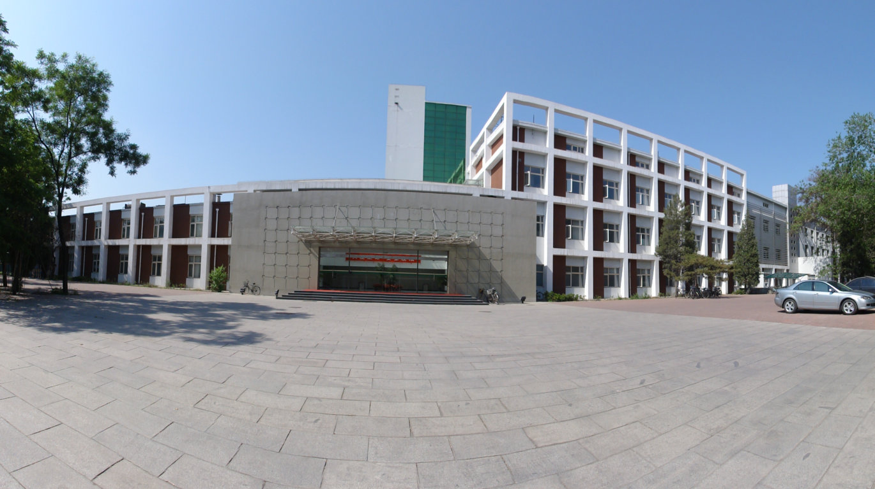
Thank you for your attention !

