Slide 1
MASSIMO (Measurements in Adapted Spectra of Spectral Indices and Material Oscillations): A Proposed Experimental Campaign at the NRAD Reactor
A. Hummel, J. Bess, G. Palmiotti, M. Salvatores, G. Imel*
Idaho National Laboratory USA
* Idaho State University
OECD/NEA WPEC SG39 Meeting
December 4, 2015
Paris, France

Slide 2
NRAD
The neutron radiography (NRAD) reactor is located in the basement, below the main hot cell, of the Hot Fuel Examination Facility (HFEF) at the Idaho National Laboratory (INL).
The NRAD reactor is a 250 kW TRIGA LEU conversion reactor that is a water-moderated, heterogeneous, solid-fuel, tank-type research reactor.
It is equipped with two beam tubes with separate radiography stations for the performance of neutron radiography irradiation on small test components
The reactor is composed of fuel in three- and four element clusters that can be arranged in a variety of lattice patterns, depending on reactivity requirements.

Slide 3
NRAD
The reactor is composed of fuel in three- and four element clusters that can be arranged in a variety of lattice patterns, depending on reactivity requirements.
The grid plate consists of 36 holes, on a 6-by-6 rectangular pattern, that mate with the end fittings of the fuel cluster assemblies.
The NRAD LEU core configuration contains 60 fuel elements, two water-followed shim control rods, and one water-followed regulating rod.
A water hole is provided as an experimental irradiation position.
The NRAD reactor uses graphite neutron reflector assemblies located along the periphery grid plate locations.

Slide 4
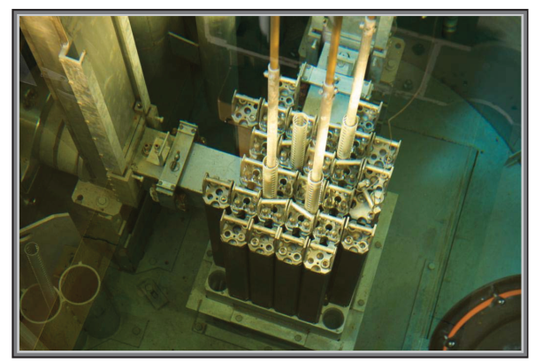
NRAD

Slide 5
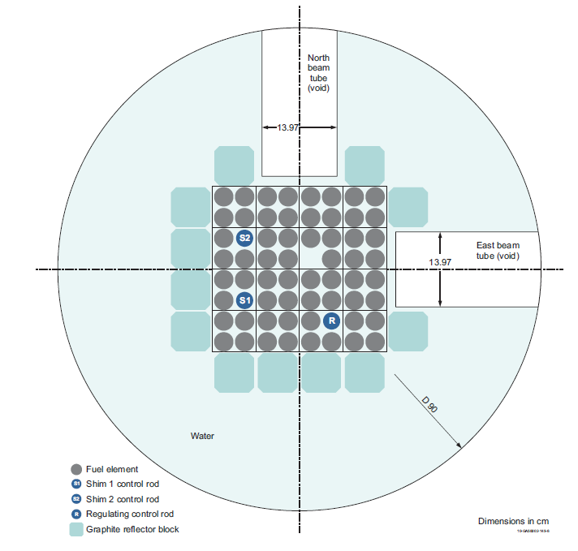
NRAD 60 Fuel Elements

Slide 6
Study for Possible Multispectra MA Mesurements
Parametric study for assessing if a critical configuration can be achieved with the experimental zone voided of water and filtered for modulating spectra.
Possible measurements:
Reactivity sample oscillation
Spectral indices
Flat and steep adjoint experiment (discarded because of insufficient room).

Slide 7
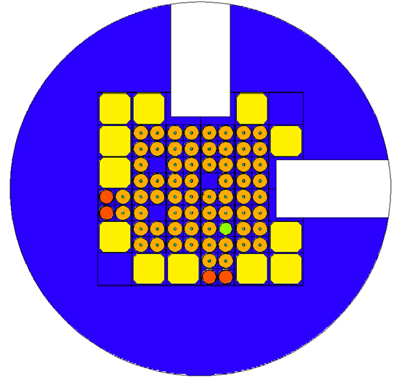
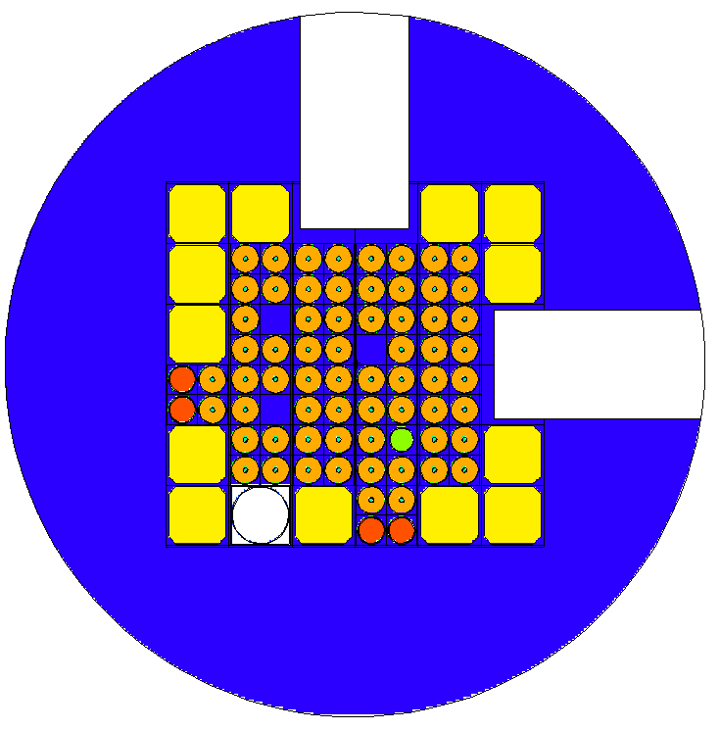
Configurations
Proposed Modification for MASSIMO
Current LEU Reference
Experimental Zone with Filters

Slide 8
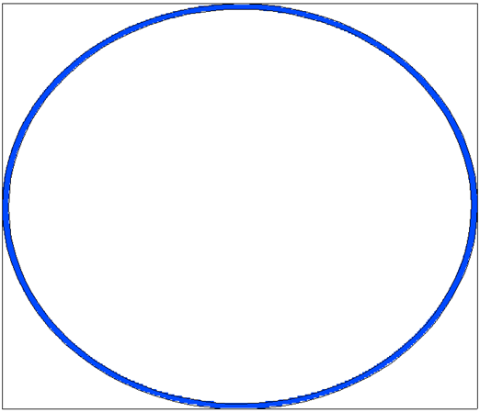
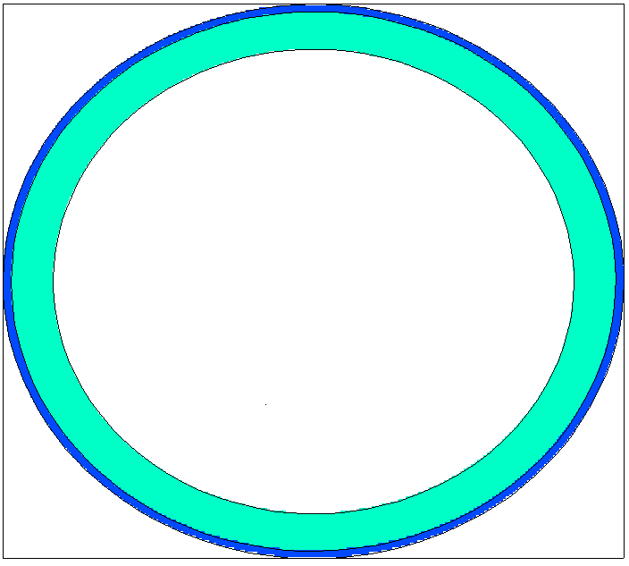
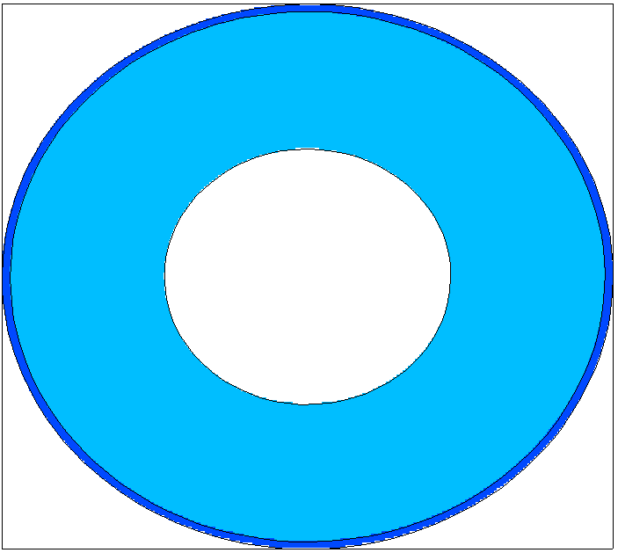
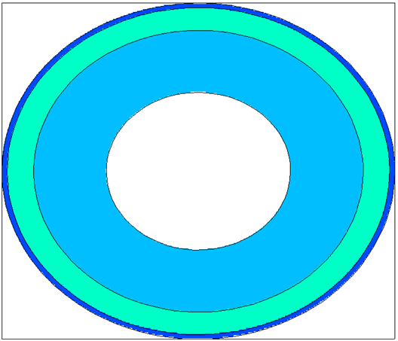
Filters
1mm Cd
1mm Cd, 5mm B
1mm Cd, 1.9 cm Depl. U
1mm Cd, 5mm B, 1.4 cm Depl. U
3.5 cm

Slide 9
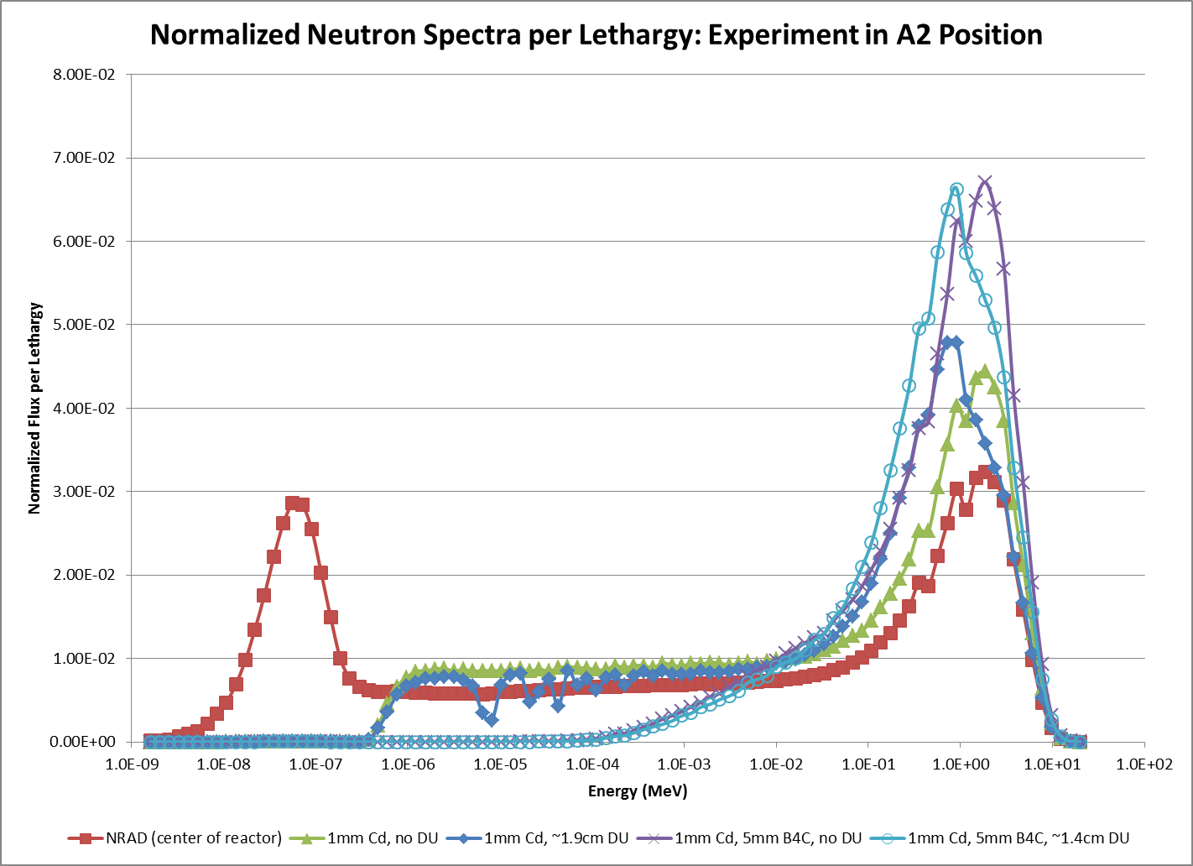

Slide 10
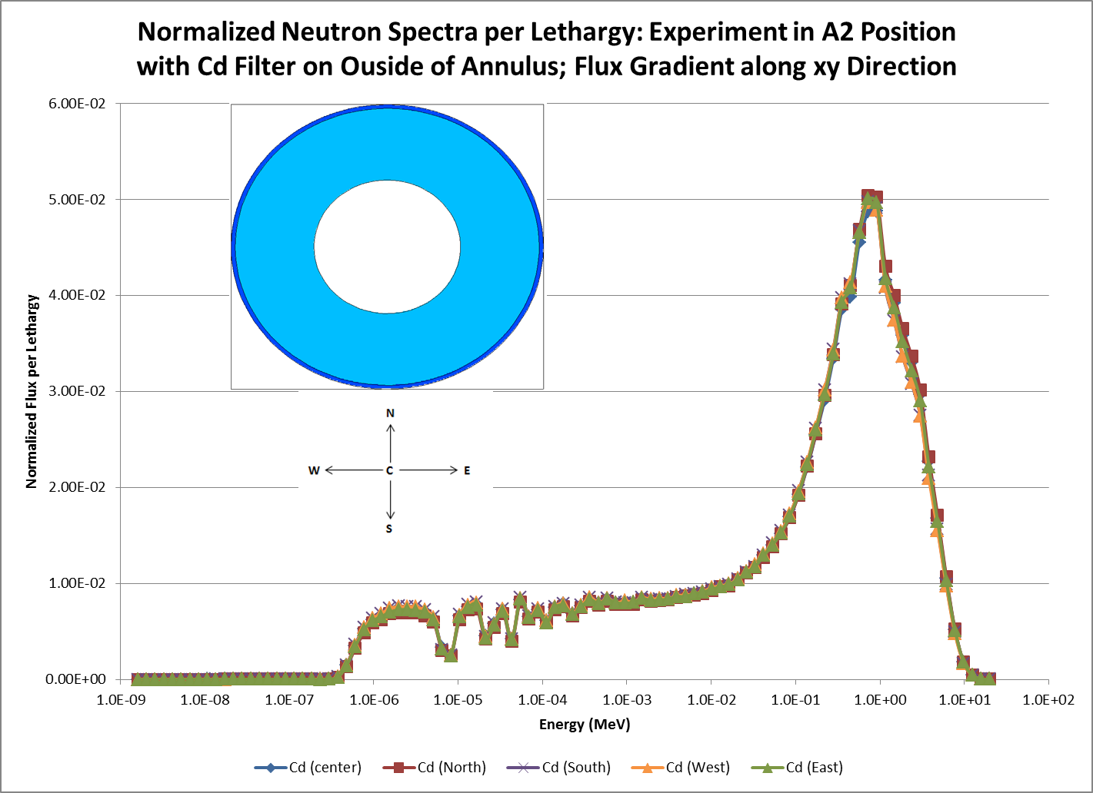

Slide 11
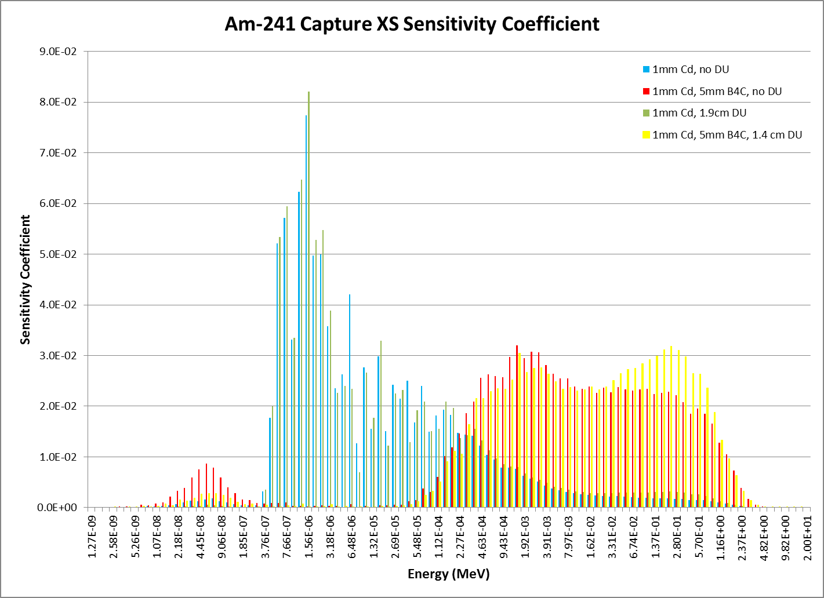

Slide 12
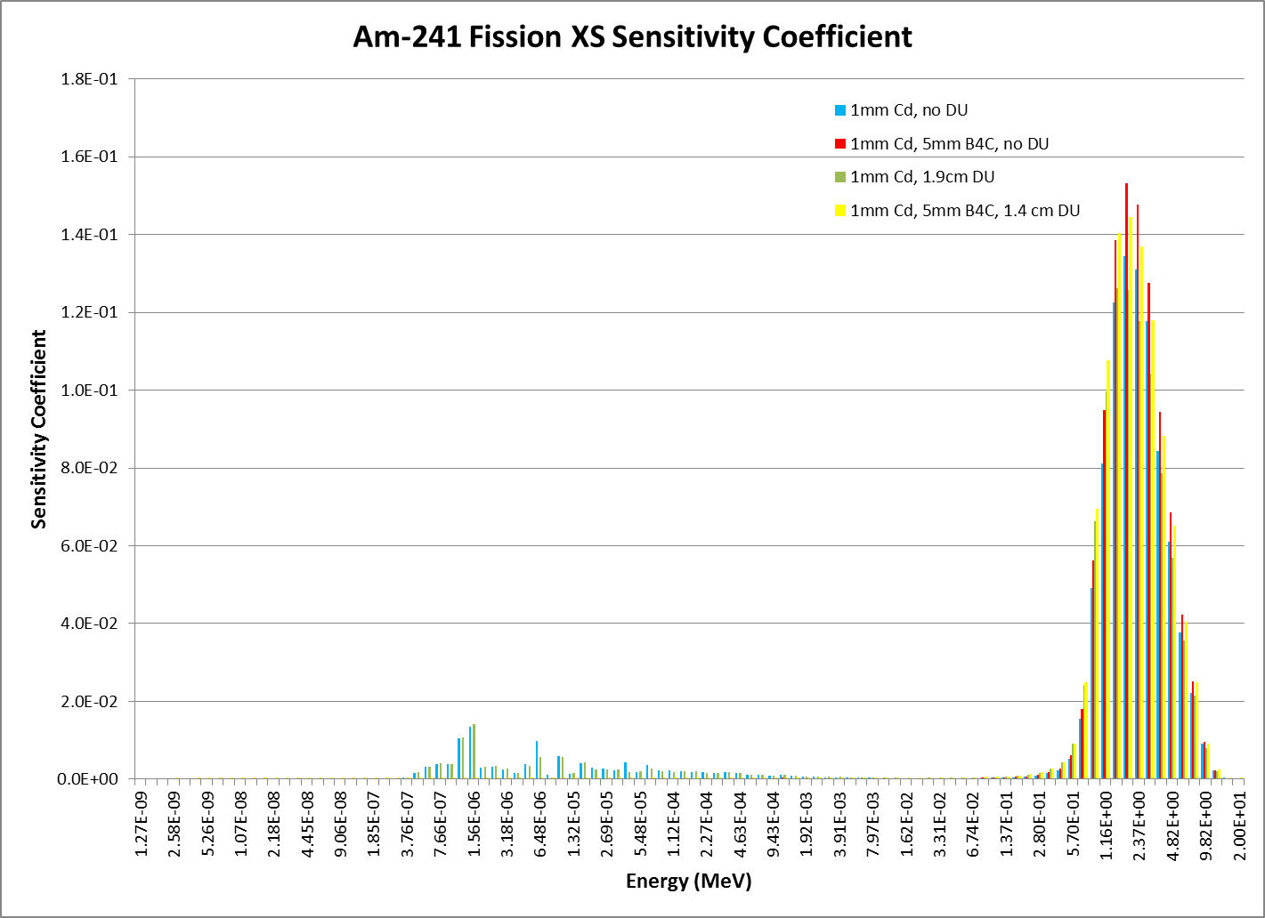

Slide 13
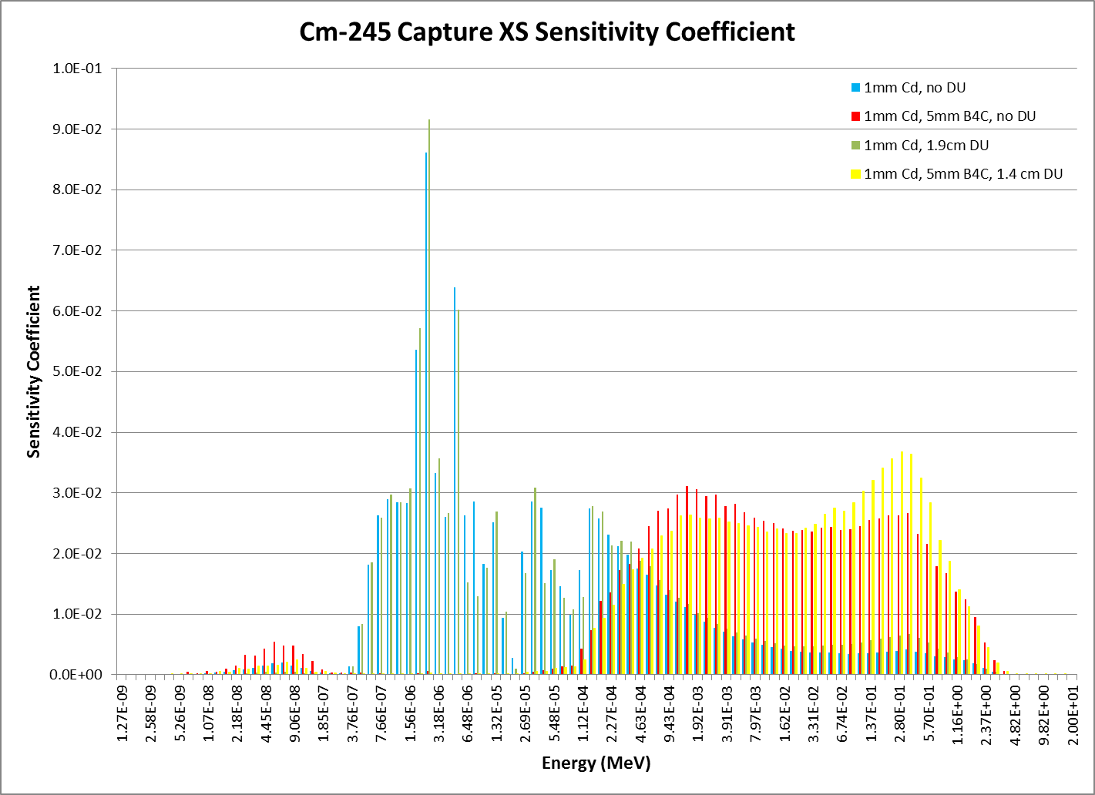

Slide 14
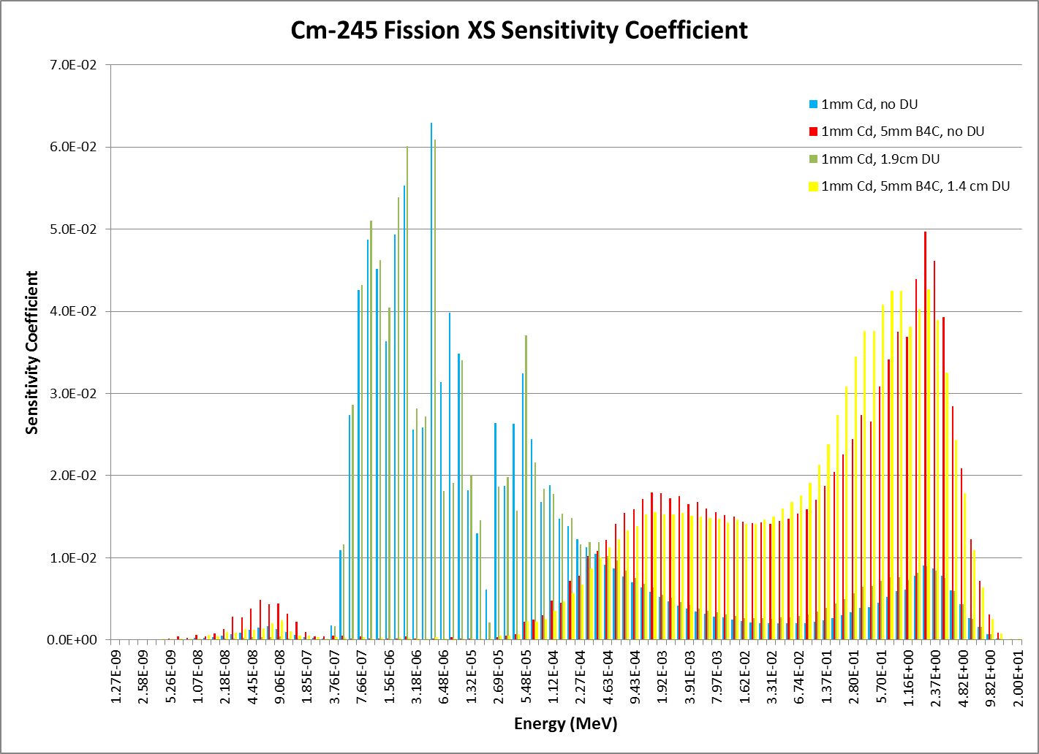

Slide 15
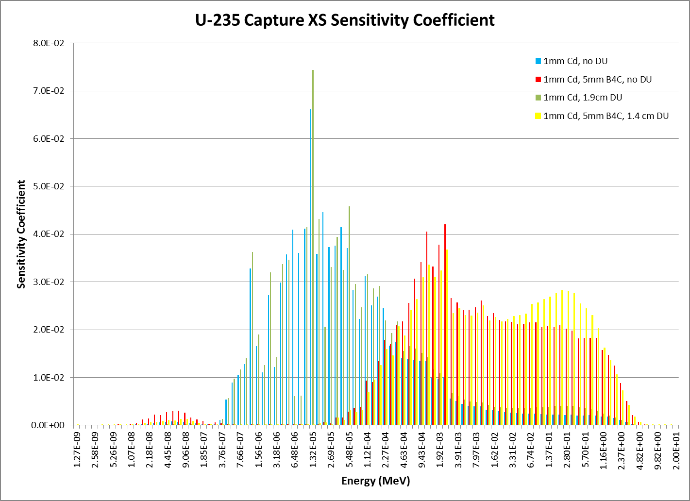

Slide 16
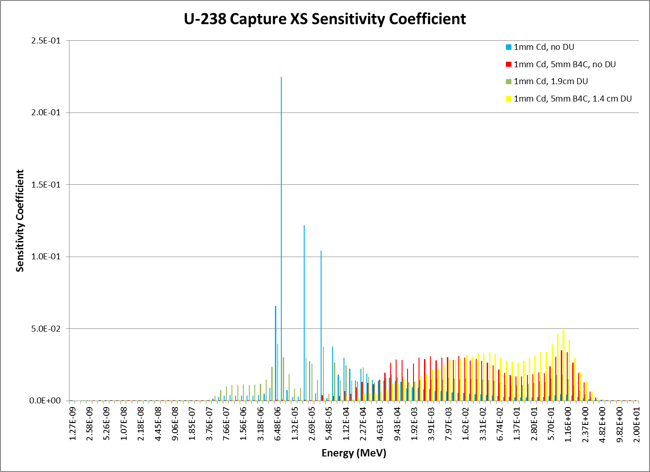

Slide 17
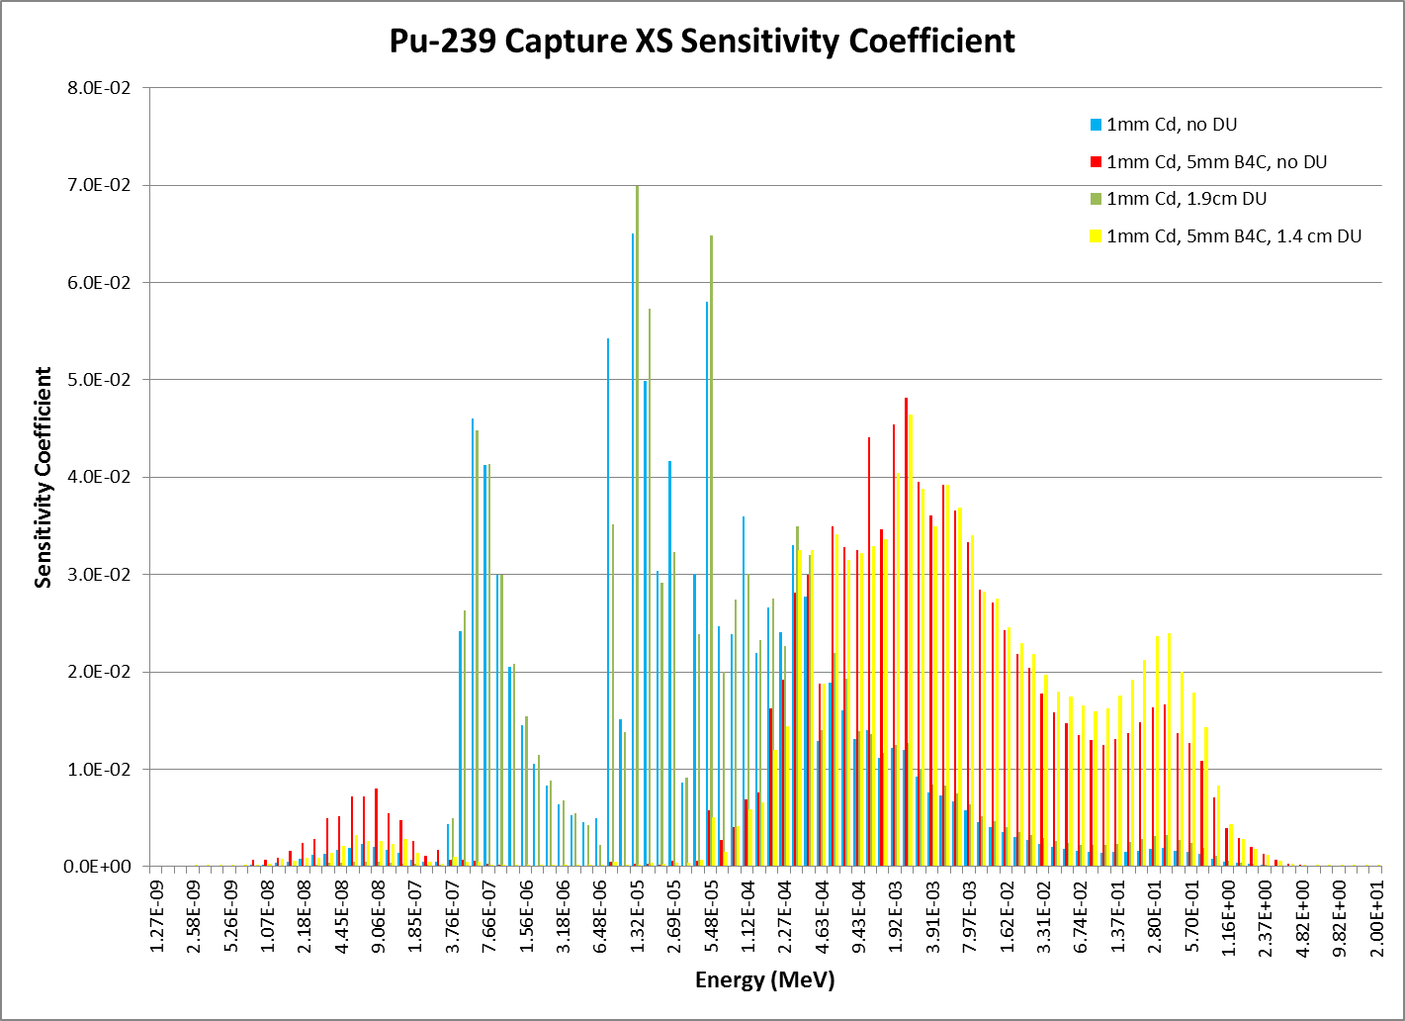

Slide 18
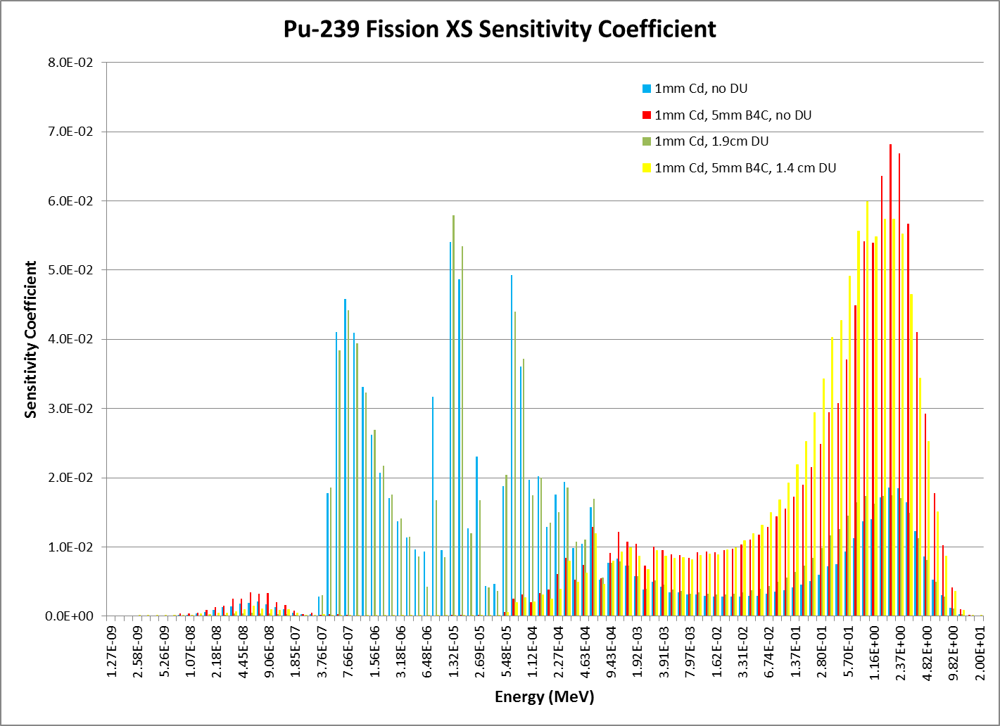

Slide 19
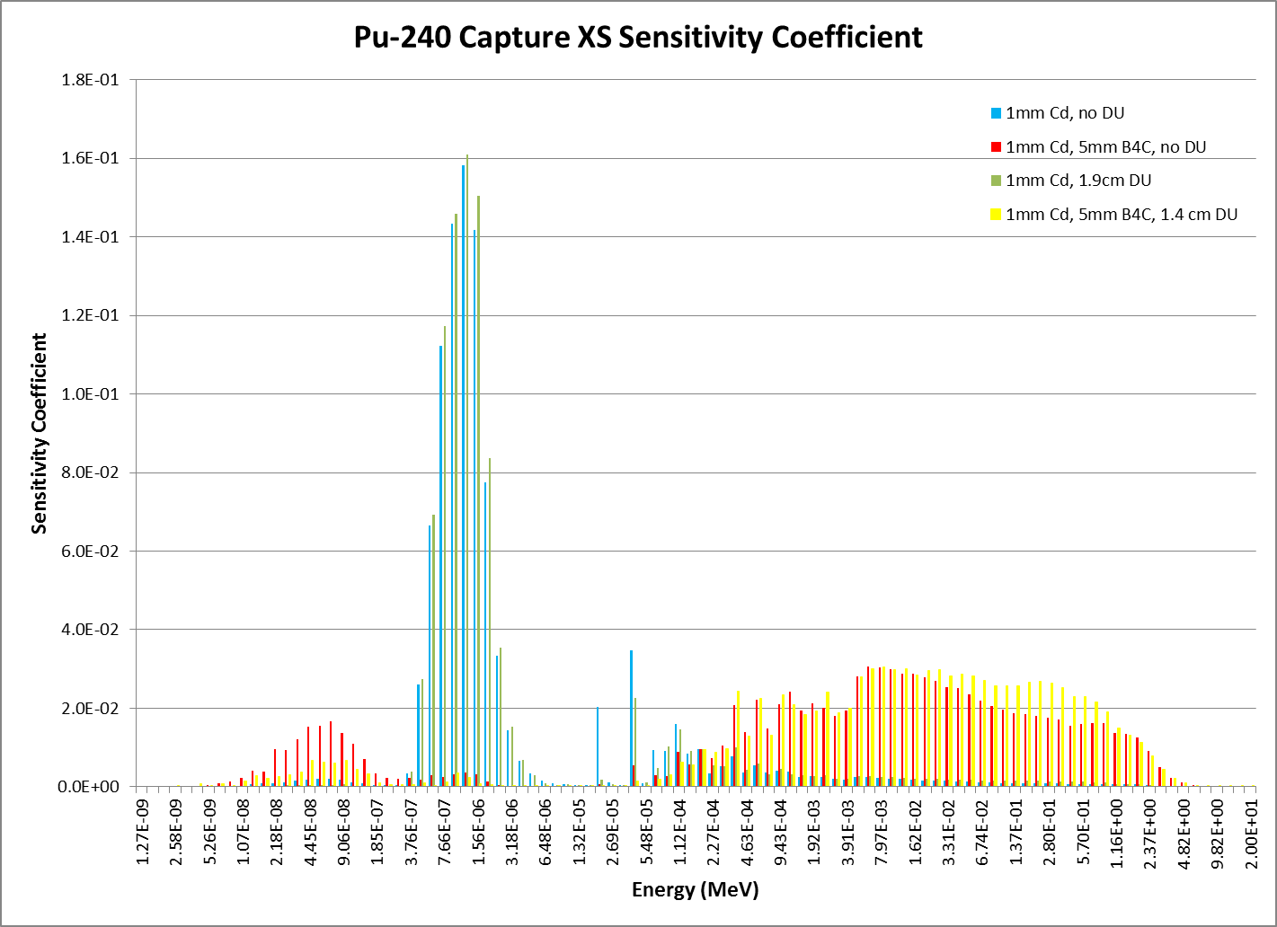

Slide 20
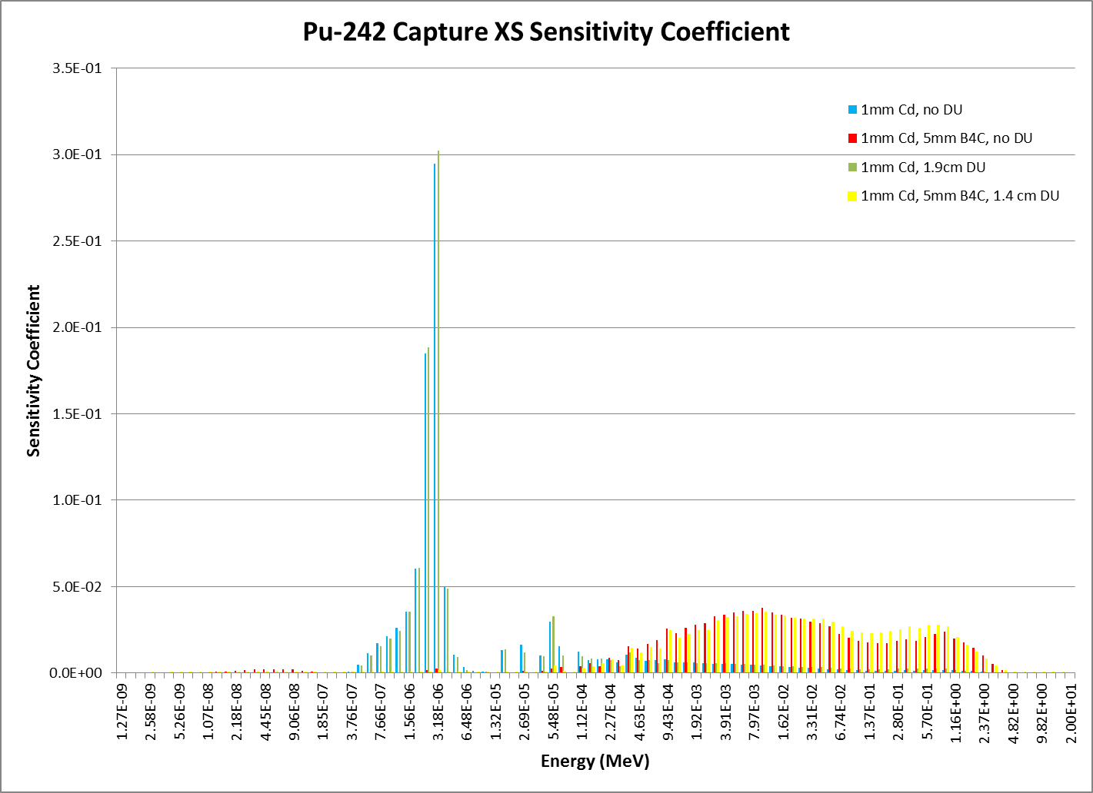

Slide 21
Spectral Indices
Use fission chambers (currently) 1 inch, but size can be reduced. They are very easy to construct and use with minimal electronics.
The great advantage is the ability to change fission foils (under a hood) between measurements (it takes about 15 minutes, max).
The chambers are run at atmospheric pressure with flow through counting gas. The counting is done in 2π geometry, so 99% of the counts represent an actual fission in the deposit.
If absolute mass of the deposit is known, fission rate per gram is known at about 1%. Back to back yields ratios lead to even higher precision as long as the flux is not too anisotropic.

Slide 22
Spectral Indices
Availability of new mass separator allows to build fission chambers for MA isotopes.
Only few micrograms are needed.
Possible isotope candidate for new fission chambers:
²³⁸Pu
²⁴¹Pu
^{242m}Am
²⁴³Am
²⁴⁴Cm
²⁴⁵Cm

Slide 23
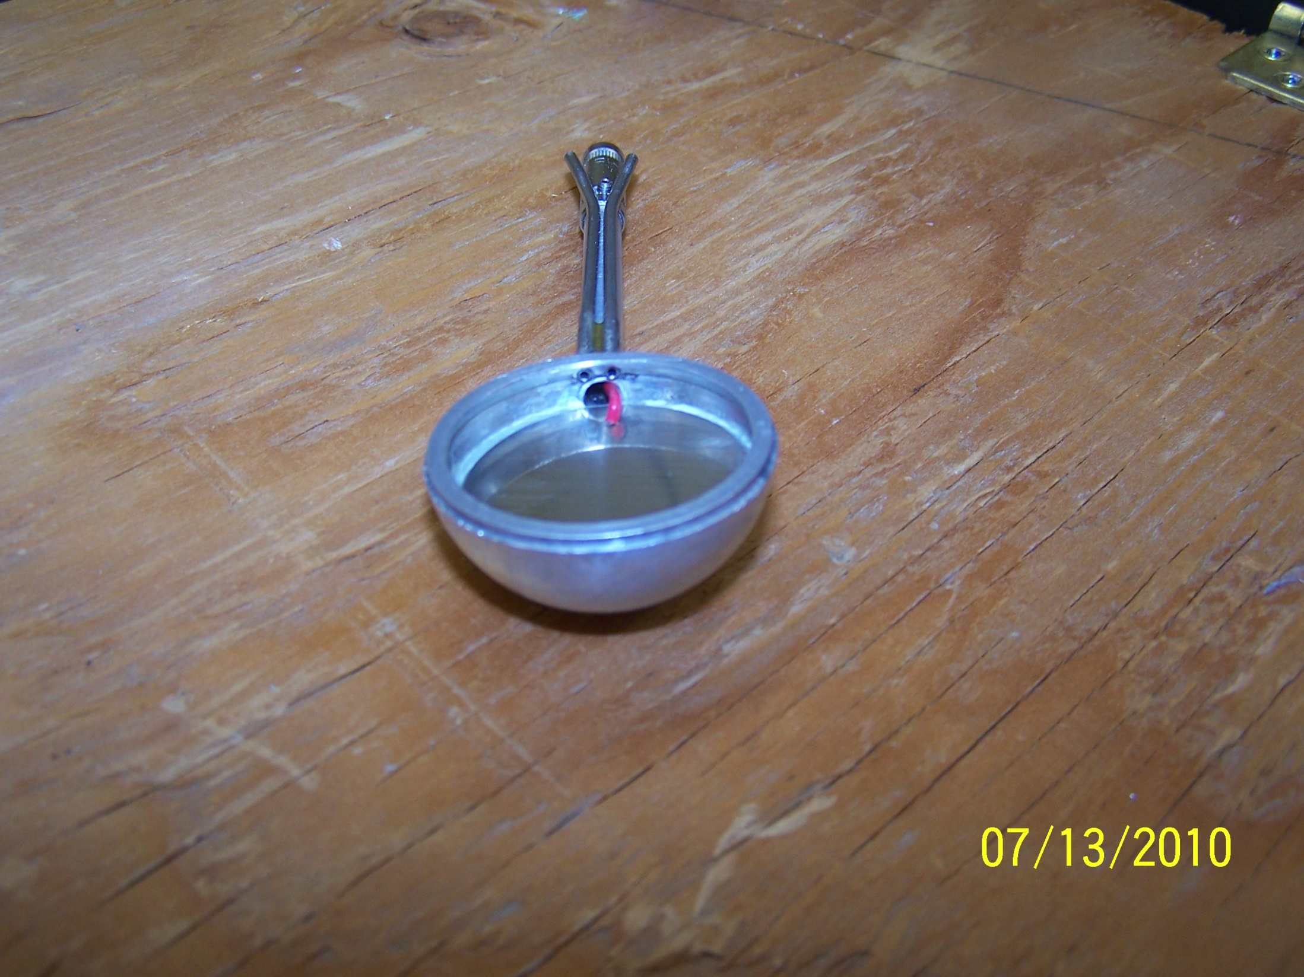

Slide 24
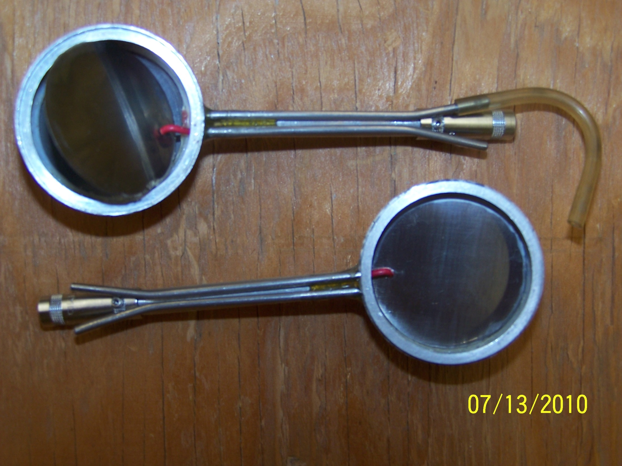

Slide 25
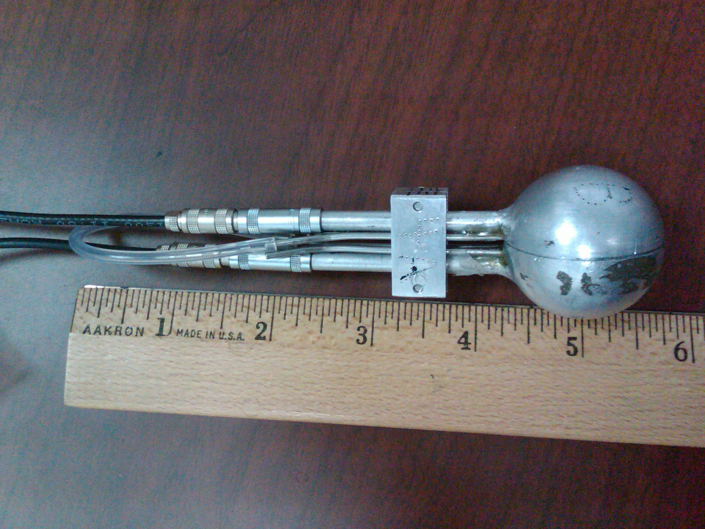

Slide 26
Material Oscillations
Closed and Open Loop Oscillator available and tested at ISU reactor. Open loop preferred: ability of measuring reactivity effects of very small worth samples (less than 0.05 cents).
In the open-loop system the reactor power is allowed to follow the oscillations freely and the reactivity is inferred by inverse kinetics.
Possible candidate for material oscillations:
Major Actinides
Minor Actinides
Fission Products
Structural Materials:
(Na, Fe, Cr, Ni, Pb, etc.)

Slide 27
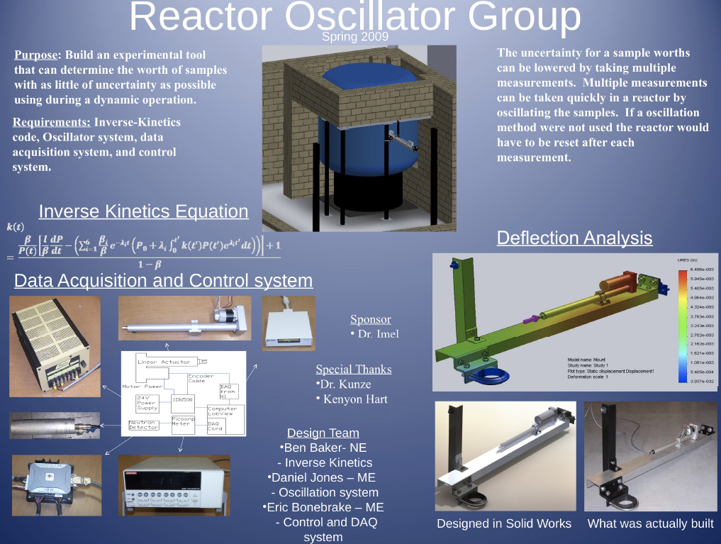

Slide 28
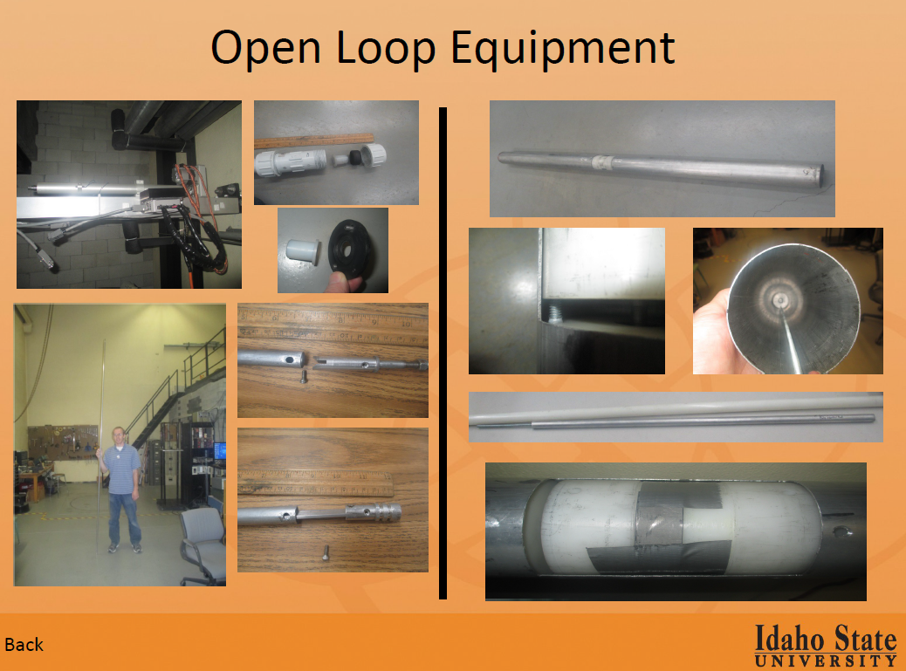

Slide 29
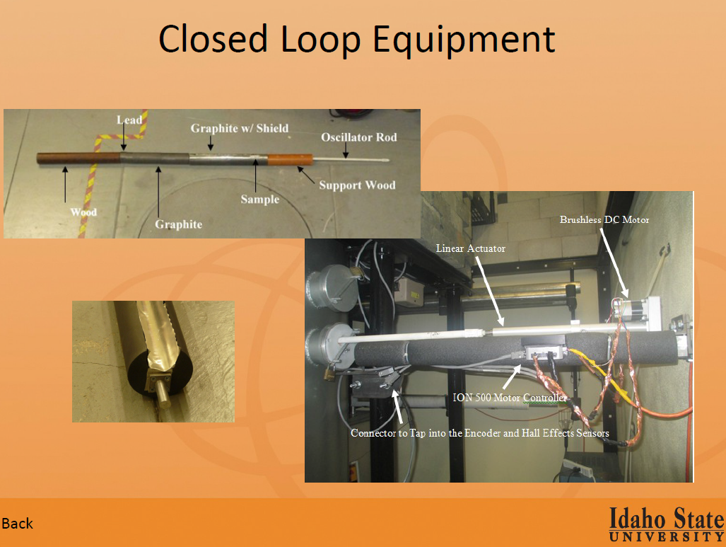

Slide 30
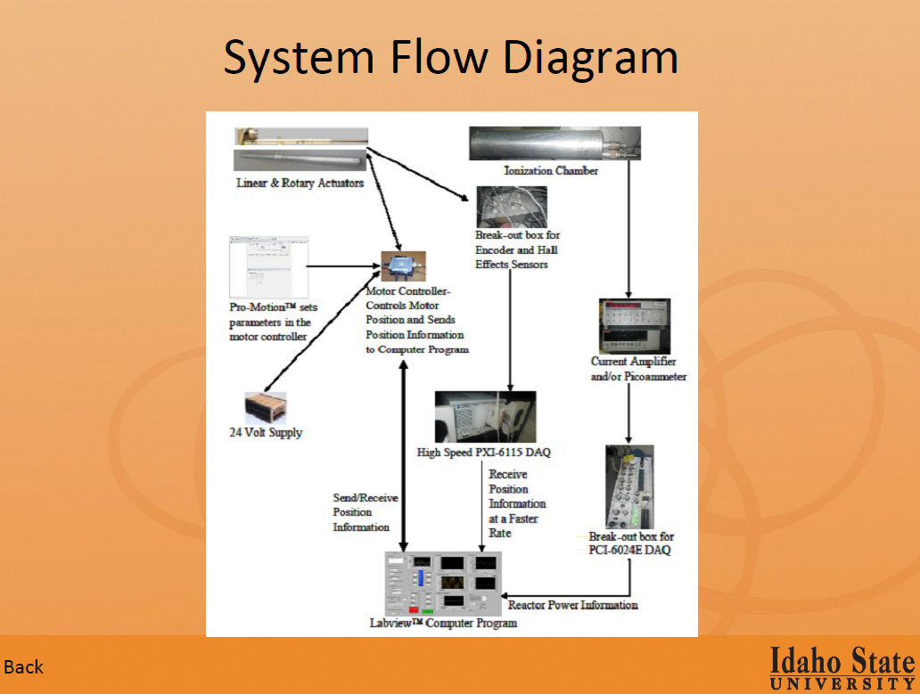

Slide 31
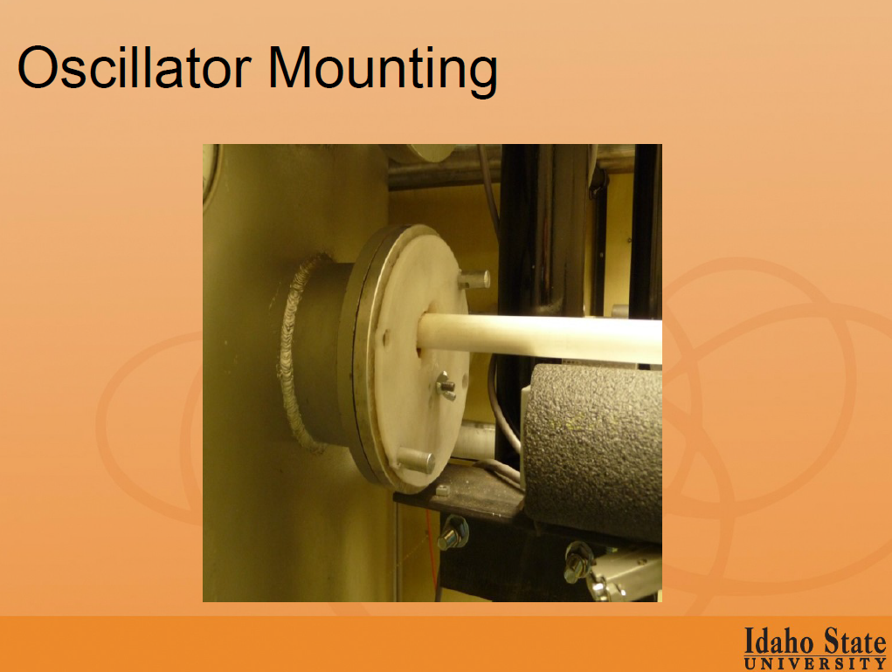

Slide 32
Conclusions
A possible experimental campaign to be performed at the NRAD reactor is under consideration.
The goal is to carry out spectral indices and reactivity oscillation measurements in a multispectra environment using filters at the experimental location.
A parametric investigation is currently under way in order to assess the viability of the proposed experimental campaign both in terms of reactivity requirements without interfering with the current mission of the reactor (neutron radiography) and what possible spectra can be obtained.
Funding opportunities are under exploration and laboratory management is supportive.
External (in kind) participation is welcome and would be helpful in supporting the funding case.

