Slide 1
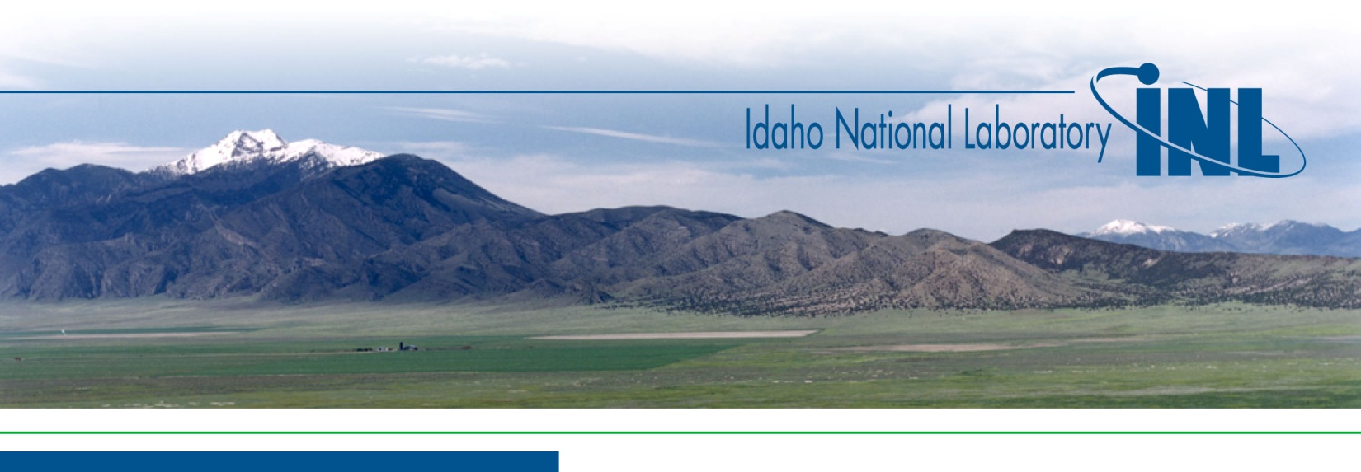
MANTRA-2: Proposal for a Second Irradiation Experiment in the ATR
G. Youinou, G. Palmiotti, M. Salvatores
Third Meeting of the Expert Group on Improvement of Integral Experiments Data for Minor Actinide Management
NEA WPEC SG39 – December 4, 2015

Slide 2
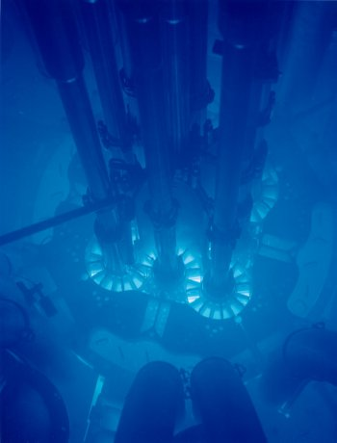
MANTRA-1 Irradiation Campaigns in 2012-2013
Three Neutron Filters: → 1 mm Cadmium → 5 mm Boron (70% ¹⁰B) → 10 mm Boron (70% ¹⁰B)
End of Irradiation in ATR:
→ 1/2013 for 5-mm B
→ 1/2013 for Cd
→ 1/2014 for 10-mm B
Irradiation Time: → 55 days for Cd-filtered → 110 days for B-filtered

Slide 3
Loading plan for thin-boron-filtered samples (same for thick-boron filtered samples)
21 capsules for samples: 19 for actinides + 2 for FP
Th-232, U-233, U-235, U-236, U-238, Np-237 (2), Pu-239, Pu-240, Pu-242 (2), Pu-244 (2), Am-241 (2), Am-243 (2) and Cm-248 (2)
NB: Cm-244 will be used only for cadmium-filtered irradiation
Sm-149, Eu-153, Cs-133, Rh-103
4 extra-capsules for U-235 wires to measure the total fluence + spectrum wires
Loading plan for cadmium-filtered samples = boron-filtered samples + 3 capsules
2 capsules for Cm-244
1 capsules for Nd-145 and Pd-105 (Ru-101 and Nd-143 to be loaded in the Sm-149 capsule)

Slide 4
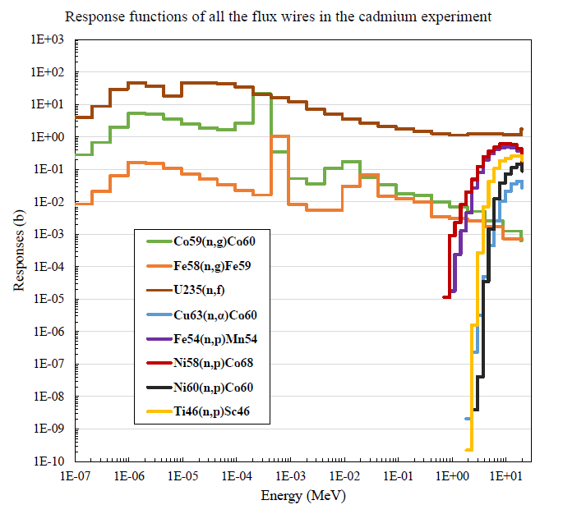
Selected Preliminary C/E for Cd Filter
New PIE results for A+2 and A+3 provided for Cd filter. Also better normalization (burn up indicators) will allow to reduce uncertainties.
Full results for Cd filters PIE for A and A+1 also provided at end of September.
Plan to include reconstructed flux energy spectra in the C/E evaluation in order to reduce uncertainty. Available information:

Slide 5
Radioactive Isotope Mass Separator
In response to the growing need for radioactive isotopic reference standards, Idaho National Laboratory is developing a capability to separate and isolate radioactive isotopes. A mass separator designed for radioactive materials has been constructed and is currently being tested.
Operation currently scheduled for 2016.

Slide 6
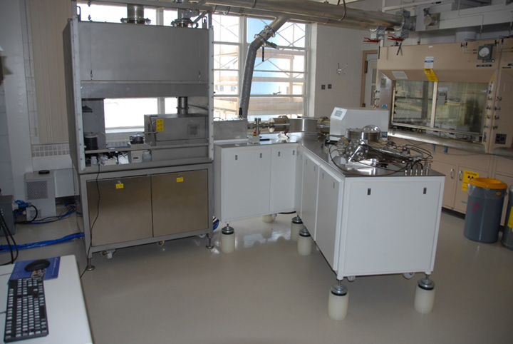
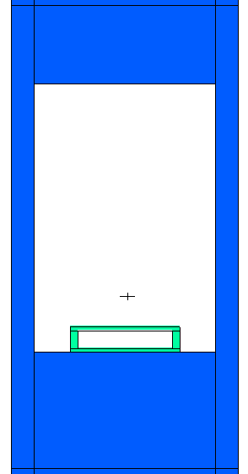
MANTRA-2 Proposal
Campaign focused on Minor Actinides samples in fast spectrum
Currently Cm-244 only in epithermal spectrum (MANTRA-1 Cd irradiation) – Use of the mass separator to purify the available Cm-244 material to make it appropriate for irradiation in a fast spectrum.
Also because of the inadequate Pu-238 and Pu-241 purity, these samples were not considered in MANTRA-1 – Use of the mass separator to purify the available material to make it appropriate for irradiation experiment
Possibility to use a neutron filter other than B¹⁰ to harden the spectrum even more – Optimize filter design based on MANTRA-1 experience
If necessary, longer irradiation campaign (4 uninterrupted cycles instead of 2 in MANTRA-1) to increase the amount of transmutation products and lower uncertainties
Prepare samples in a known geometrical form (e.g. wafer) instead of powder as in MANTRA-1 to better control irradiation conditions
Chose sample mass and geometry to minimize neutron energy self-shielding – Better control of the initial sample mass
Still use the MC-ICP-MS which has proven very valuable for MANTRA-1

Slide 7


MANTRA-2 Proposal
MANTRA-1 was funded by ATR National Scientific User Facility and also by DOE Office of Science and/or NE Office.
Funding mechanism may be similar for MANTRA-2
Possible start date in 2017 or 2018
Pre-proposal to be prepared by May 2016 and finalized (if selected) by August 2016. It should include as much as possible external support commitments.
MANTRA-2 could be open to international collaborations in the framework of this NEA Expert Group
  Staff exchange
  Participation in the design and analyses
  Participation in sample preparations
Commitment to be formalized by next Expert Group meeting (spring 2016).
Support of NSC at December 2016 Bureau meeting?

