Slide 1


ONGOING ACTIVITIES ON INTEGRAL EXPERIMENTS RELATED TO NUCLEAR DATA FOR FAST REACTOR APLICATIONS
DEN/CAD/DER/SPRC/LEPh | Pierre Leconte, David Bernard, Cyrille de Saint Jean
DEN/CAD/DER/SPEx/LPE | Patrick Blaise, Benoit Geslot, Paul Ros
SG39 Meeting, Paris, December 4th, 2015

Slide 2
OUTLINE
Coupled fast/thermal experiments
Reanalysis of ERMINE/ZONA1 experiments on FP
Design of an optimized coupled fast/thermal configuration for ZEPHYR
Shielding/transmission experiments
EXCALIBUR experiment on ²³⁸U(n,n’)
Feasability of shielding experiments in GELINA
Tests on Fe, Cr and Ni reflectors in CROCUS
Fast neutron activation experiments
Minor actinide activation in TAPIRO
FP samples

Slide 3
COUPLED FAST/THERMAL EXPERIMENTS Overview of ERMINE experiments
Time Period | Experiment | Core configurations | Framework | Measurements
1966-1967 | ERMINE-I | type MAS1B | Development of experimental techniques | Spectral indices, Doppler reactivity worth (20-450°C)
1967-1970 | ERMINE-II | U2 (type MAS1B) | Investigation on Doppler effect | Doppler reactivity worth (20-800°C)
1968-1970 | ERMINE-II | U2 (type MAS1B) | Measurement of η = νσ_{f} / σ_{a} for ²³⁵U and ²³⁹Pu | Local/global oscillations on ²³⁹Pu and ²³⁵U, spectral indices
1970-1975 | ERMINE-III/IV | Uranium: U1, U2(MAS1B), UK1, UK5, R1, R2, R2’, OU10 Plutonium: P1, P2, OP1, OP10, OP11, OP20, OP40, OP41, OP50, KP1, KP2 | Investigation of Plutonium isotopes | k_{inf}=1, spectral indices, reactivity worth of ^{239,240,241}Pu + irradiated fuels from RAPSODIE
1971-1972 | ERMINE-III | H_{o}, H₁, H₂, H_{p} (Homogeneous cores) | Investigation on structural materials | Spectral indices and reactivity worth of Fe, Cr, Ni, Ti, Co, Zr, Nb, Mo, W, acier, ^{235,238}U, ²³⁹Pu
1975-1980 | ERMINE-V/VI | ZONA1, ZONA3, RONA3, R3 | Investigation on absorbing fission products | Neutron activation and reactivity worth of ⁹⁸Mo, ⁹⁹Tc, ¹⁰³Rh, ¹³³Cs, ¹⁴¹Pr, ^{102,104}Ru, ^{105,108}Pd, ¹³⁹La, ¹⁰⁹Ag, ¹⁴²Ce, ^{146,148}Nd, ¹⁴⁷Pm, ^{147,152}Sm + irradiated fuels from PX and RAPSODIE
1979-1980 | ERMINE-VI | OA10, ON10 | Investigation on structural materials | k_{inf}=1, reactivity worth of Fe, Cr, Ni, Mo, Mn, Ti, Co, Aciers, Inconel
1981-1985 | ERMINE-VI | ROCA1, ZOCA13, OU15 | Investigation on lattices with large heterogeneities | k_{inf}=1, spectral indices, flux distribution
4 décembre 2015
| PAGE 3

Slide 4
COUPLED FAST/THERMAL EXPERIMENTS Use of ERMINE experiments for nuclear data adjustment/improvement
Before 1990 : CARNAVAL-III and CARNAVAL-IV
Contribution to the production of an adjusted ND library for PX and SPX calculations
1990-2000 : ERANOS / ERALIB1
Several inconsistent results between ERMINE, MSK and PX/SPX
The ERALIB1 adjusted library only accounts for:
k_{inf} measurements from ERMINE-III experiments (OP10/40/50, OP11/41, OA10,ON10)
Spectral indices in the H_{o} homogeneous core
2000-2010 : ERANOS2 / JEFF3
No ERMINE experiment accounted for the validation of the new code system
Since 2010: APOLLO3 / RNR code system for ASTRID
1st step: critical analysis of the ERMINE database
Reliability of data: core loading, material balance, technological uncertainties…
Relevance toward ASTRID needs
2nd step: reanalysis of relevant experiences with reference calculation codes/methods
⇨ The ERMINE-V/ZONA1 experiment was the first test to demonstrate the relevance of the newly implemented exact perturbation method in TRIPOLI4 (IFP-based) for the analysis of reactivity worth experiments
4 décembre 2015
| PAGE 4

Slide 5
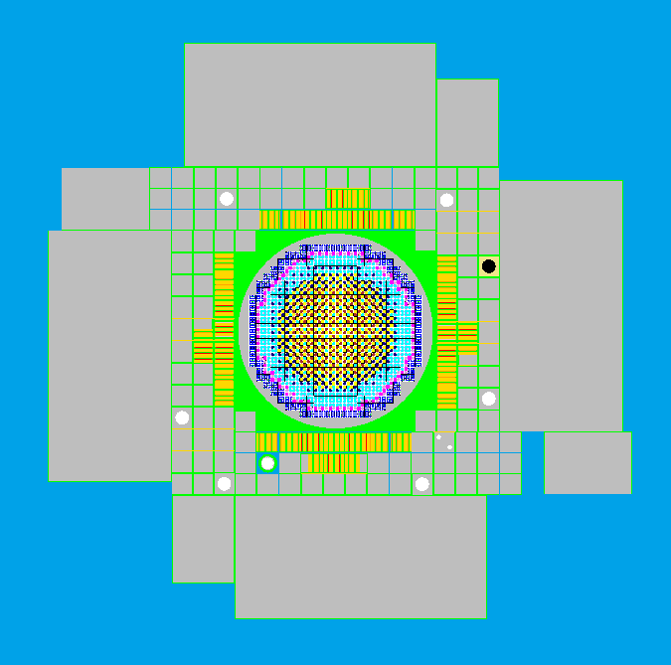
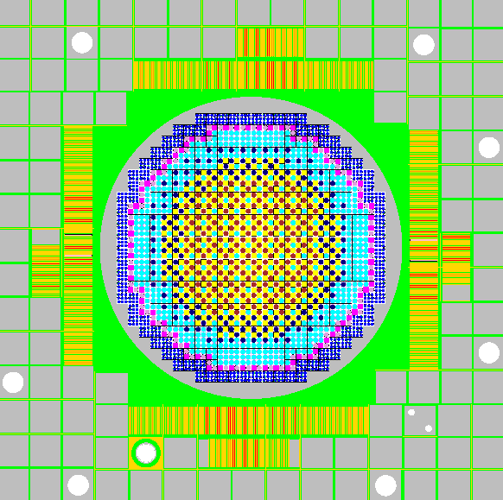
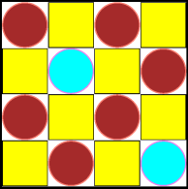
COUPLED FAST/THERMAL EXPERIMENTS TRIPOLI4 model of the ERMINE-V/ZONA1 core
Central channel for pile-oscillation and activation experiments
Graphite reflector
MTR fuel assemblies
Driver zone (thermal)
Experimental zone (fast)
Hf control rods
Rotative pilot rod (Cd sectors)
Light water pool
ZONA1 cell
UO₂-3.5% fuel pins
MOX-27%
UO₂-27% rodlet
Graphite+Boron pins
UO₂-nat
UO₂-nat and U-dep rodlets
4 décembre 2015
Na
| PAGE 5

Slide 6
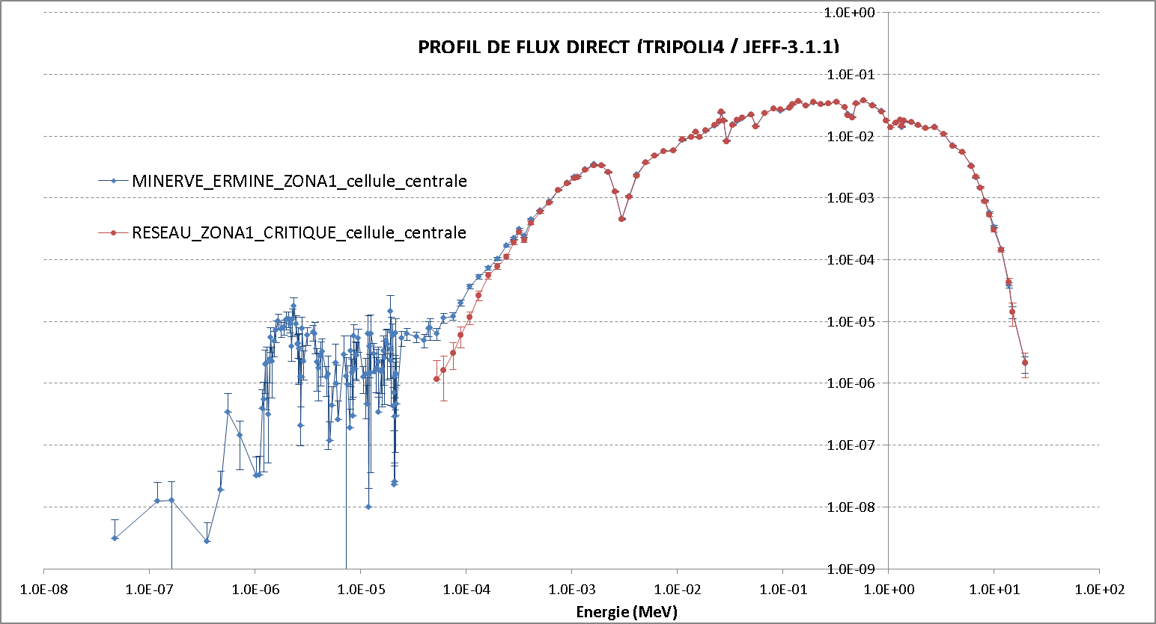
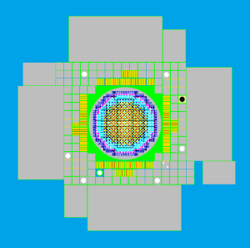
COUPLED FAST/THERMAL EXPERIMENTS Spectrum characterization in the coupled core configuration
Forward flux comparison with a critical homogeneous core of ZONA1 cells
ERMINE-V/ZONA1 core configuration
10⁴
Homogeneous core of ZONA1 cells
Energy (MeV)
4 décembre 2015
| PAGE 6

Slide 7
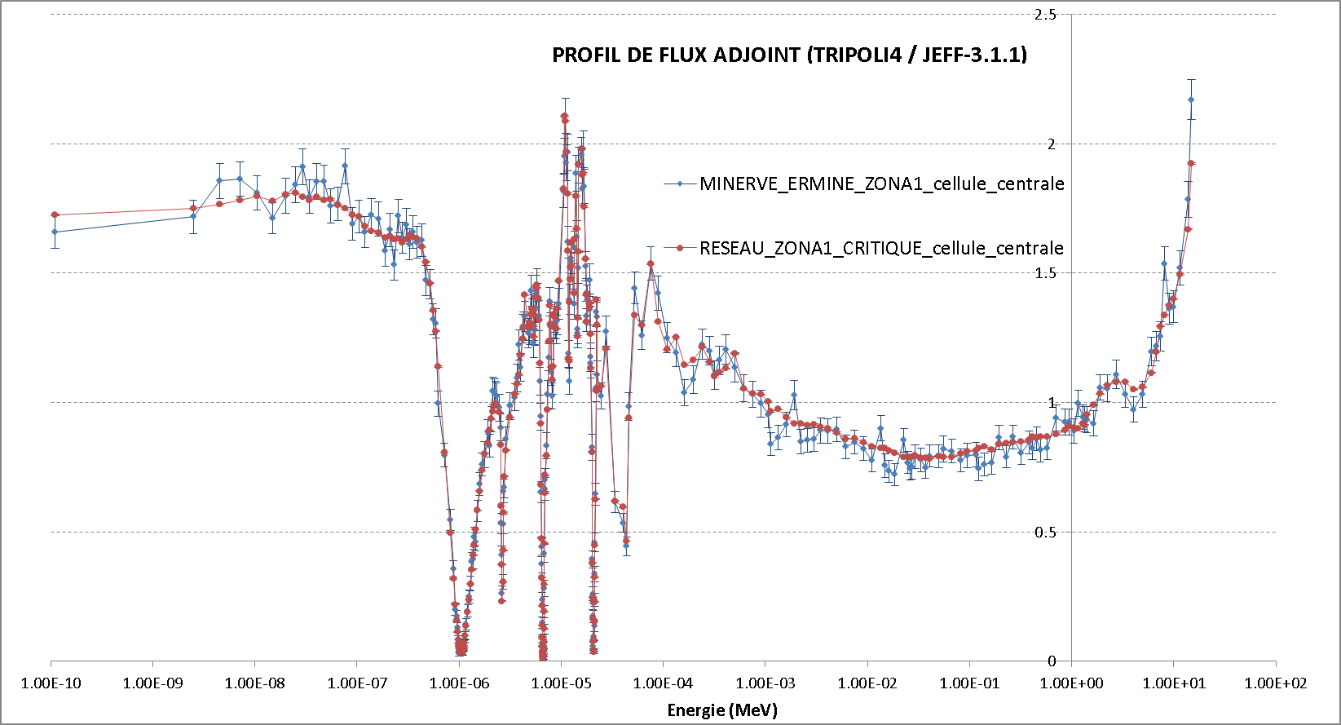
COUPLED FAST/THERMAL EXPERIMENTS Spectrum characterization in the coupled core configuration
Adjoint flux comparison with a critical homogeneous core of ZONA1 cells
ERMINE-V/ZONA1 core configuration
Homogeneous core of ZONA1 cells
Energy (MeV)
4 décembre 2015
| PAGE 7
4 décembre 2015

Slide 8
COUPLED FAST/THERMAL EXPERIMENTS Reanalysis of the ERMINE-V/ZONA1 experiments on FP
Reactivity worth experiments
Code / ND lib. | C/E-1 (%) Uncertainties (1σ) account for experiment and MC convergence
 | ⁹⁹Tc | ¹⁰³Rh | ¹³³Cs
CARNAVAL-IV / RCN-2A (1980) | 46 ± 5 | 17 ± 1.4 | 23 ± 13
TRIPOLI4.9 / JEFF3.1.1 (2014) | 14 ± 5 | -5.5 ± 2 | -1 ± 13
Neutron activation experiments
Code / ND lib. | C/E-1 (%) Uncertainties (1σ) account for experiment and MC convergence
 | ⁹⁸Mo | ¹⁰⁰Mo | ¹⁰⁴Ru | ¹⁰⁸Pd | ¹⁴²Ce | ¹⁴⁶Nd | ¹⁴⁸Nd | ¹⁵⁰Nd | ¹⁵²Nd
CARNAVAL-IV / RCN-2A (1980) | 25 ± 5 | 16 ± 5 | 15 ± 4 | 23 ± 5 | 69 ± 5 | 10 ± 4 | 30 ± 5 | -2 ± 5 | 118 ± 10
TRIPOLI4.9 / JEFF3.1.1 (2014) | 20 ± 5 | -5 ± 5 | -13 ± 4 | 4 ± 5 | 48 ± 5 | -8 ± 4 | -1 ± 5 | 44 ± 5 | -21 ± 10
Other experimental results are planned to be analysed in the near future:
Additionnal samples of ¹⁰²Ru, ¹⁰⁵Pd, ¹⁰⁹Ag, ¹⁴¹Pr, ¹⁴⁷Pm and ¹⁴⁷Sm
Several core configurations: ZONA3, RONA3 and R3 cores
⇨ A full review of these experiments is going to be presented at ND2016
4 décembre 2015
| PAGE 8

Slide 9
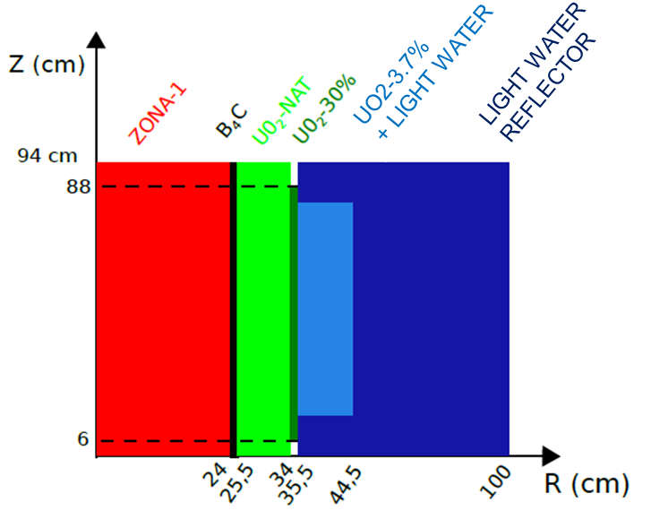
COUPLED FAST/THERMAL EXPERIMENTS Definition of an optimized configurations for ZEPHYR
CEA has the will to start a new ZPR in the next decade: ZEPHYR
Mock-up experiments for GEN-II and GEN-III reactors
Nuclear Data dedicated experiments for GEN-II, GEN-III and even GEN-IV reactors
⇨ PhD of P. Ros (2014-2017): definition of optimized coupled core configurations in ZEPHYR
Main features of the optimized coupled fast/thermal configurations
Substitution of MINERVE MTR assemblies to regular PWR-type UO₂ fuel pins
Better efficiency of the conversion zone (UO₂-30%)
Spectral adaptation with a UO₂ zone to match the ZONA1 spectral characteristics
Boron filter for remaining thermal neutrons + negative reactivity coefficient in case of core flooding
Small increase of the ZONA-1 zone
⇨ More details in a paper submitted for PHYSOR2016
4 décembre 2015
| PAGE 9

Slide 10
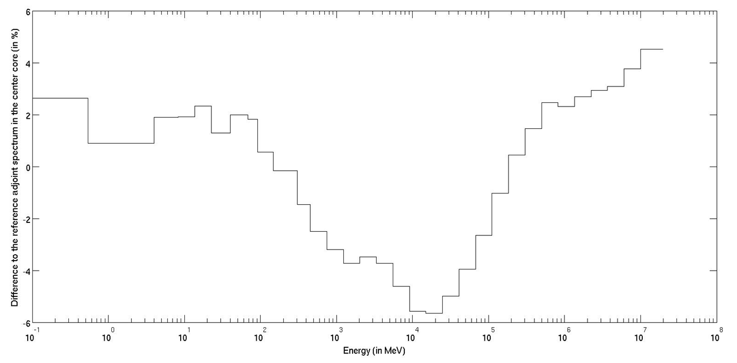

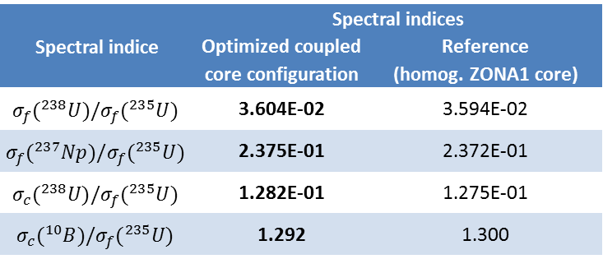
COUPLED FAST/THERMAL EXPERIMENTS Spectral characterisation of the optimized fast/thermal configuration
Energy group (MeV) | Forward flux spectrum (% of total flux)
 | Optimized coupled core configuration | Reference (homog. ZONA1 core)
19.6 | 6.6 | 6.5
2.23 | 22.9 | 22.7
4.97E-01 | 43.5 | 43.6
6.74E-02 | 24.7 | 25.0
2.03E-03 | 2.3 | 2.1
2.26E-05 | 9.1E-04 | 1.2E-05
5.40E-07 | 2.6E-06 | 2.6E-06
Adjoint flux adaptation
Spectral indice | Spectral indices
 | Optimized coupled core configuration | Reference (homog. ZONA1 core)
$$σ_{f}({}_{}^{238}U)/σ_{f}({}_{}^{235}U)$$ | 3.604E-02 | 3.594E-02
$$σ_{f}({}_{}^{237}{Np})/σ_{f}({}_{}^{235}U)$$ | 2.375E-01 | 2.372E-01
$$σ_{c}({}_{}^{238}U)/σ_{f}({}_{}^{235}U)$$ | 1.282E-01 | 1.275E-01
$$σ_{c}({}_{}^{10}B)/σ_{f}({}_{}^{235}U)$$ | 1.292 | 1.300
⇨ Spectral conditions very close to the fundamental mode in the central position of the core
| PAGE 10

Slide 11
OUTLINE
Coupled fast/thermal experiments
Reanalysis of ERMINE/ZONA1 experiments on FP
Design of an optimized coupled fast/thermal configuration for ZEPHYR
Shielding/transmission experiments
EXCALIBUR experiment on ²³⁸U(n,n’)
Feasability of shielding experiments in GELINA
Tests on Fe, Cr and Ni reflectors in CROCUS
Fast neutron activation experiments
Minor actinide activation in TAPIRO
FP samples

Slide 12
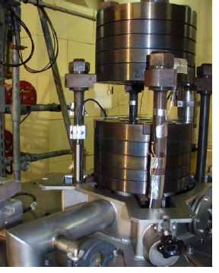
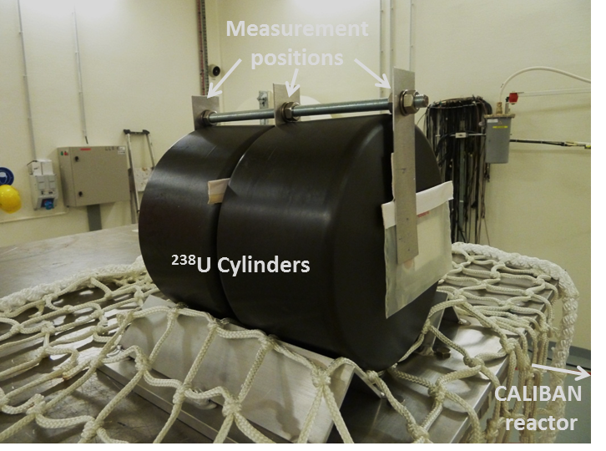
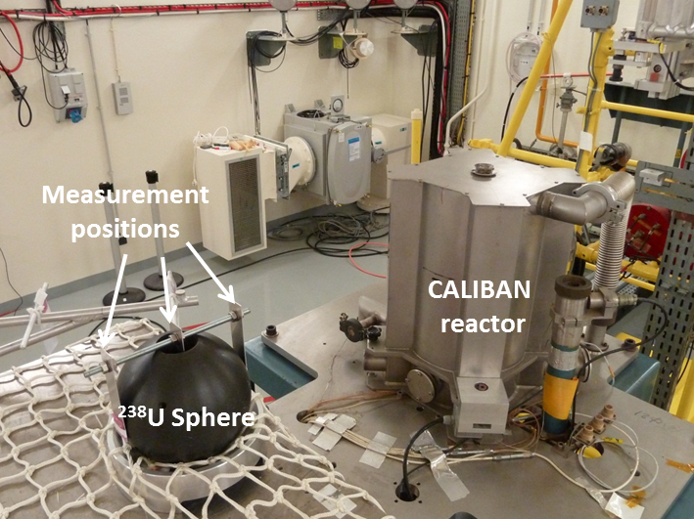
EXCALIBUR EXPERIMENT ON ²³⁸U(N,N’)
Integral transmission through Uranium
Project « EXCALIBUR » is part of the CEA/DEN and CEA/DAM collaboration on nuclear data:
EXperiment in CALIBAN on URanium 238
Neutron source: bare Highly Enriched Uranium Fast Reactor CALIBAN
2 blocks of 5 disks (φ = 19.5cm, h=2-3cm)
UMo(10%) with 93.5% ²³⁵U/U
Pulse mode (nominal), power step mode
Two different uranium devices
1st campaign (jan. 2014): one sphere of φ=17cm
2nd campaign (oct. 2014): two cylinders of φ=18cm, h=9cm
4 décembre 2015
| PAGE 12

Slide 13


EXCALIBUR EXPERIMENT ON ²³⁸U(N,N’)
Integral transmission through Uranium
The transmission rate was measured using various threshold reaction dosimeters
γ-spectrometry measurements on [HP]Ge
Target statistical uncertainty: less than 1% (1σ)
Redundant countings, samples and inter-comparison of 3 labs: CEA-DAM (Valduc), CEA-DEN (Cadarache) and CNRS-LPSC (Grenoble)
Interpretation is just starting
Definition of a benchmark geometry to simplify the analysis
C/E comparisons
Sensitivity analysis to derive multigroup trends and related covariances on ²³⁸U(n,n’)
⇨ First interpretation to be presented at ND2016
4 décembre 2015
| PAGE 13

Slide 14
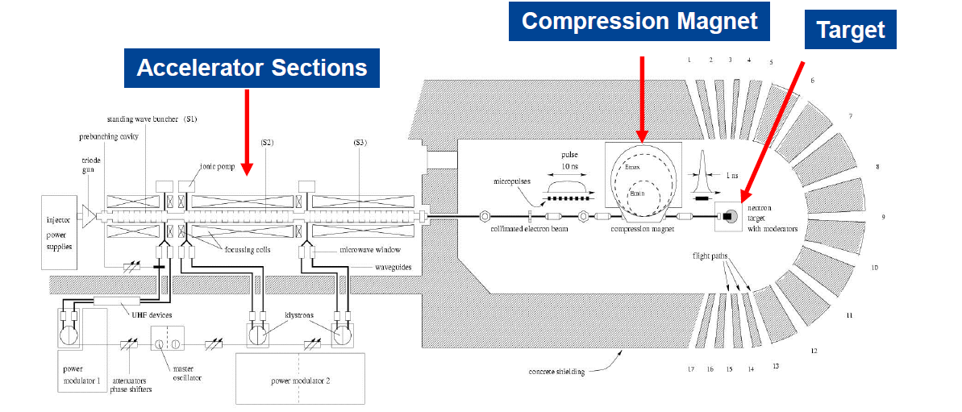
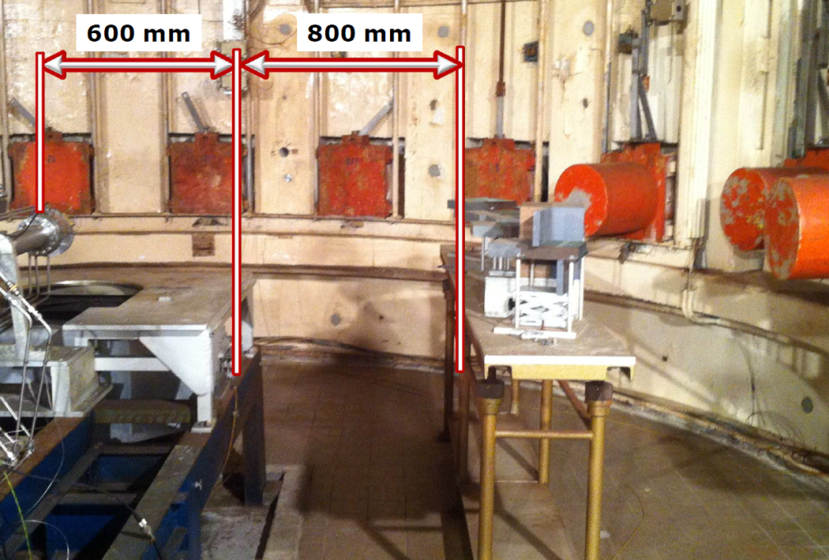
ON THE FEASIBILITY OF TRANSMISSION EXPERIMENTS AT GELINA
Use of the GELINA pulsed neutron source to perform transmission/shielding experiments in the target hall
Compared to CALIBAN
Neutron intensity is smaller (but more flexibility on the irradiation time)
Equivalent neutron spectrum shape
More flexibility to set-up the device to be irradiated
Main challenges
Minimize the room return (concrete walls and copper magnet)
Dose rate
Applications under consideration
Copper to validate the TAPIRO reflector (large blocks from ENEA)
Uranium: CEA interest to complete the CALIBAN experiments
Other materials of interest include: Fe, Na, Pb, Li
4 décembre 2015
| PAGE 14

Slide 15
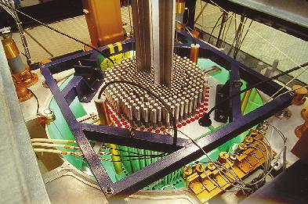
TRANSMISSION EXPERIMENTS IN CROCUS Study of separated reflectors of Fe, Cr and Ni
CROCUS
Training reactor of EPFL (P < 100W)
Developement of scientific activities following the PROTEUS phase-out
Expression of needs by CEA/SPRC
⇨ Complementary validation of individual cross sections of Fe, Cr and Ni for EPR heavy reflector (in addition to PERLE@EOLE)
⇨ Also interesting for fast reactor systems
Fe, Cr, Ni plates
Project managment between CEA/SPEx, EPFL and PSI
⇨ Definition of mechanical devices and measurement techniques
Current status: Stainless steel, Fe, Cr and Ni plates have been ordered and received
⇨ Measurement campaign could start in 2017
Top view of the CROCUS core

Slide 16
OUTLINE
Coupled fast/thermal experiments
Reanalysis of ERMINE/ZONA1 experiments on FP
Design of an optimized coupled fast/thermal configuration for ZEPHYR
Shielding/transmission experiments
EXCALIBUR experiment on ²³⁸U(n,n’)
Feasability of shielding experiments in GELINA
Tests on Fe, Cr and Ni reflectors in CROCUS
Fast neutron activation experiments
Minor actinide activation in TAPIRO
FP samples

Slide 17
FAST NEUTRON ACTIVATION EXPERIMENTS
Minor actinide activation in TAPIRO (OECD/EGIEMAM framework)
TAPIRO
Fast source reactor
Highly enriched ²³⁵U, copper reflected
OSMOSE samples from MINERVE
Separated actinides ⁽²³²Th to ²⁴⁵Cm) in UO₂
Feasability is still to be adressed
High counting rate due to fission in UO₂ matrix
Dose rate
Better characterisation of spectrum conditions in the irradiated position

Slide 18
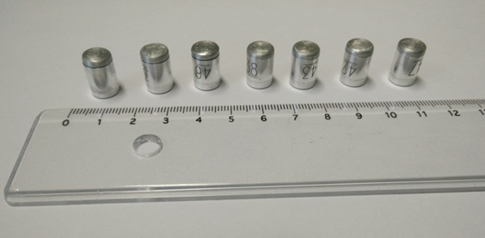
FAST NEUTRON ACTIVATION EXPERIMENTS
Validation of FP activation
FP samples initially manufacturated to be activated in CALIBAN
Pure oxides of different rare earth elements
Watertight Al and SS containers of φ=8.6x9.0mm, h=9mm
Mass ranging from 60-600mg (more details on ask)
Materials | Target reaction
Ruthenium | ¹⁰²Ru(n,γ)¹⁰³Ru ¹⁰⁴Ru(n,γ)¹⁰⁵Ru
Silver | ¹⁰⁹Ag(n,γ)^{110m}Ag
Europium | ¹⁵¹Eu(n,γ)¹⁵²Eu ¹⁵³Eu(n,γ)¹⁵⁴Eu
Cerium | ¹⁴²Ce(n,γ)¹⁴³Ce
Lanthanum | ¹³⁹La(n,γ)¹⁴⁰La
Molybdenum | ⁹⁸Mo(n,γ)⁹⁹Mo
Praseodymium | ¹⁴¹Pr(n,γ)¹⁴²Pr
Neodymium | ¹⁴⁶Nd(n,γ)¹⁴⁷Nd ¹⁴⁸Nd(n,γ)¹⁴⁹Nd
Samarium | ¹⁵²Sm(n,γ)¹⁵³Sm
Palladium | ¹⁰⁸Pd(n,γ)^{109m}Ag
Caesium | ¹³³Cs(n,γ)¹³⁴Cs
Sodium | ²³Na(n,γ)²⁴Na
Gold | ¹⁹⁷Au(n,γ)¹⁹⁸Au
Due to CALIBAN phase-out, we are still searching a neutron source to activate the samples
GELINA
TAPIRO
NRAD?

